Slide 1
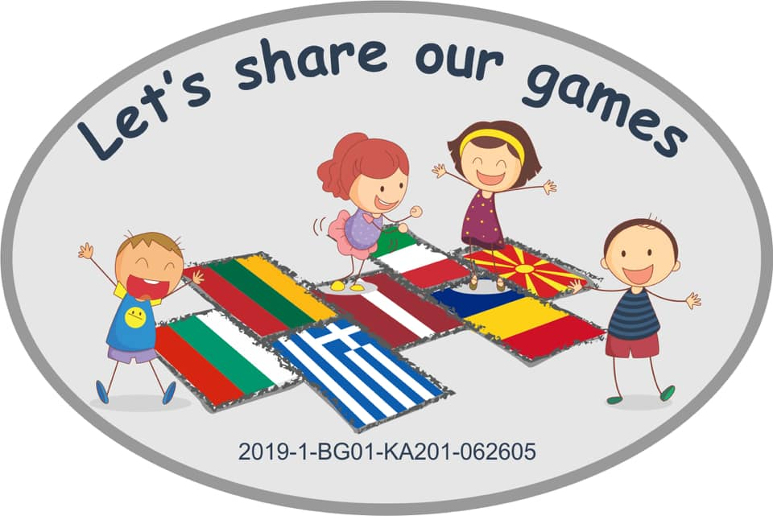
Let’s share our games
2019-1-BG01-KA201-062605
JOUDG “BRESHIA”- DEBAR

Slide 2
Let’s share our games
2019-1-BG01-KA201-062605
Forms and methods of interaction with parents
The partnership between parents and educators is essential and ever present, because it is needed and provided help to progress child faster in his mental and physical development.
Parents are always welcomed in exercises, activities that are carried out according to the annual curriculum prepared by the institution and the team.
Kindergarten doors are always open to parents and other family members who wish to be directly present during free and orientated activities.

Slide 3
Let’s share our games
2019-1-BG01-KA201-062605
Collaboration with parents is achieved through:
Parent Council in the institution
Parent meetings at the level of institution and educational group
Individual talks and consultations
Challenges of parents in the realization of the syllabus, various manifestations, celebrations holidays
Open days
Creative workshops

Slide 4
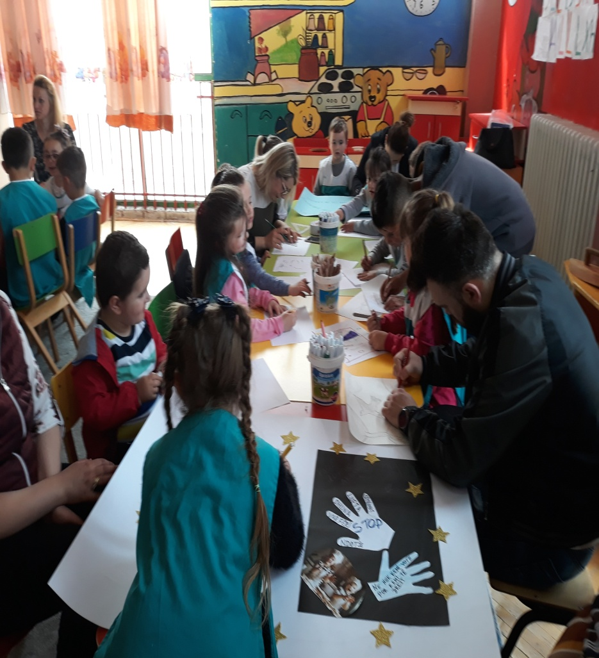
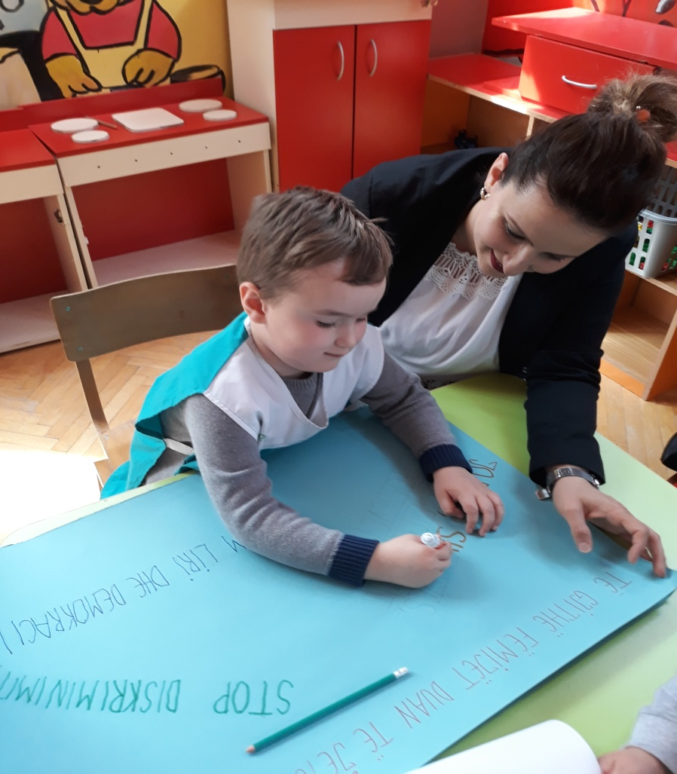
Let’s share our games
2019-1-BG01-KA201-062605
Collaboration with parents in our kindergarten:
Children’s rights week

Slide 5
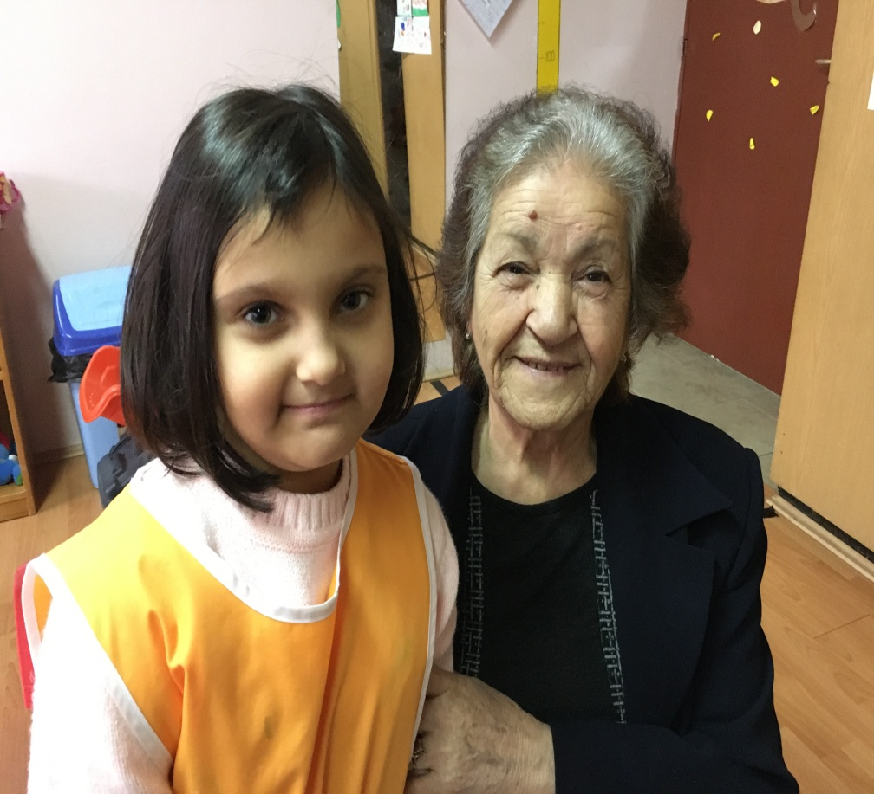
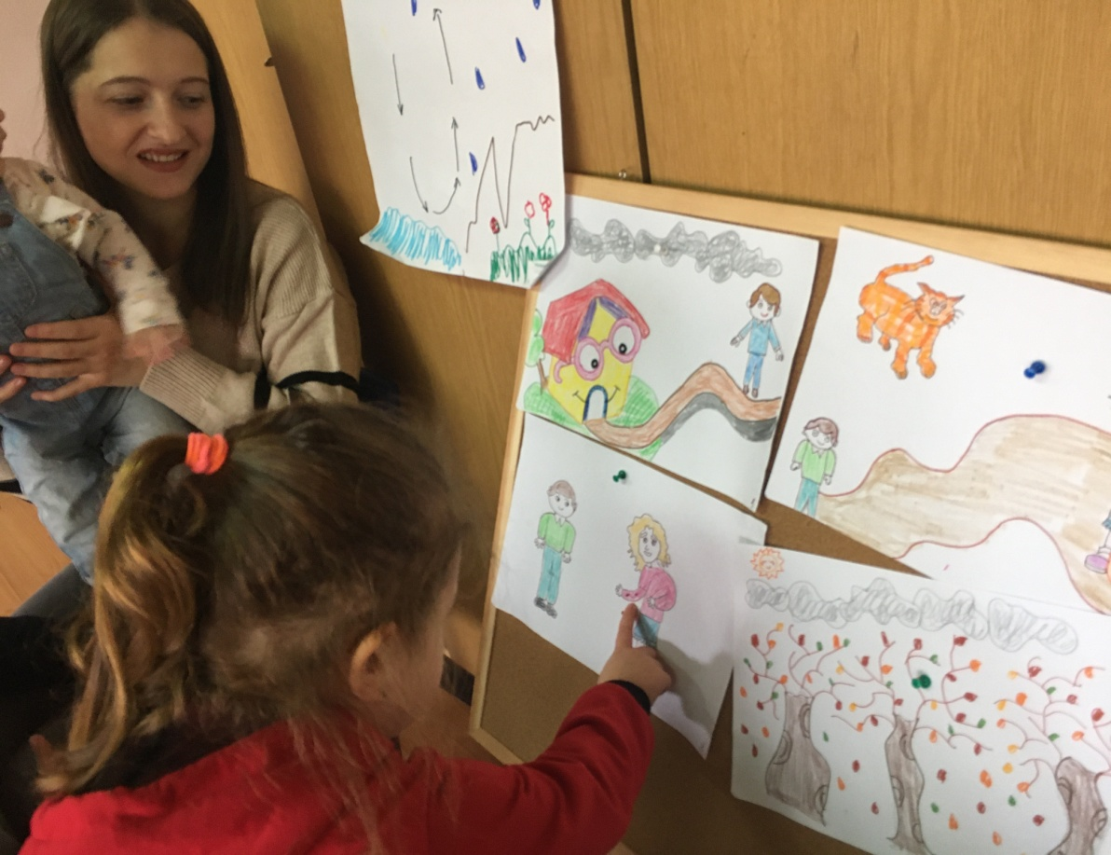
Let’s share our games
2019-1-BG01-KA201-062605
Orientated activities
Asi’ s grandmother
Xhana’s mother

Slide 6
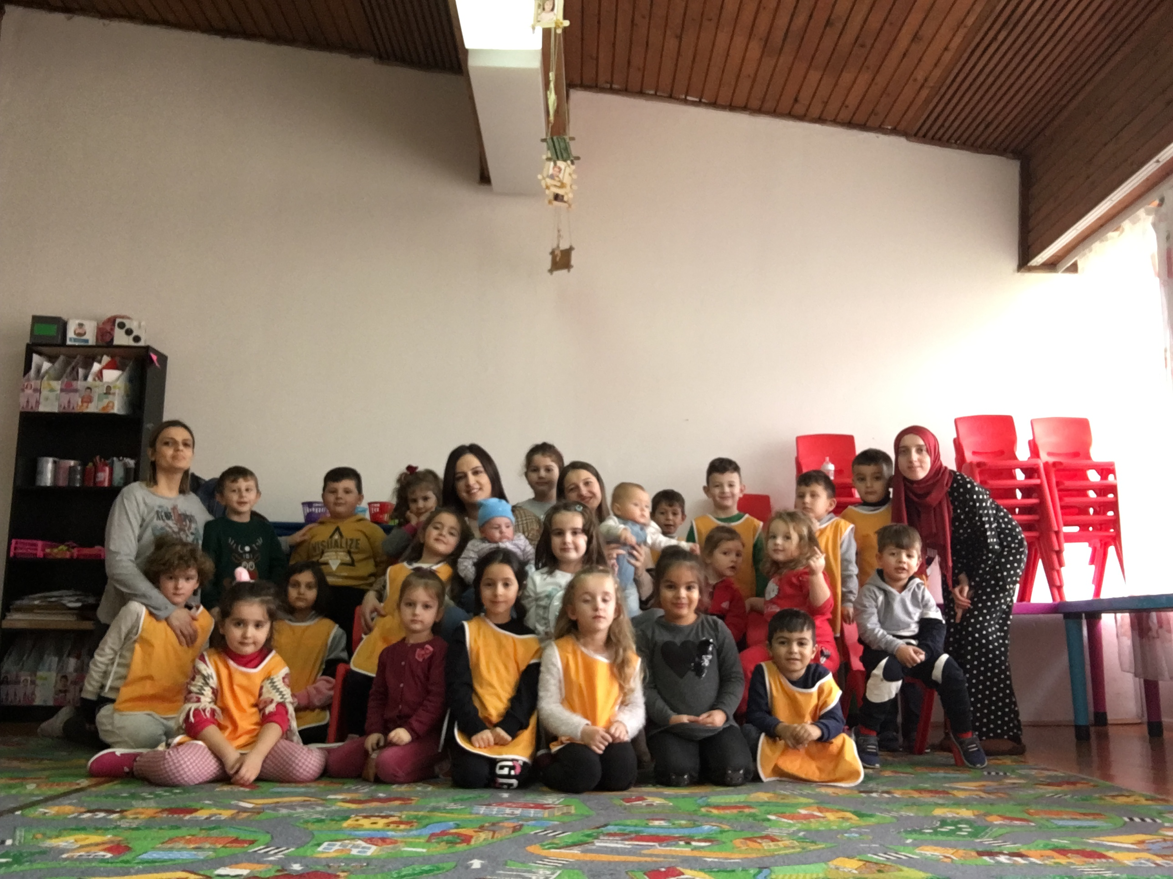
Let’s share our games
2019-1-BG01-KA201-062605
Belma and Xhana’s mothers

Slide 7
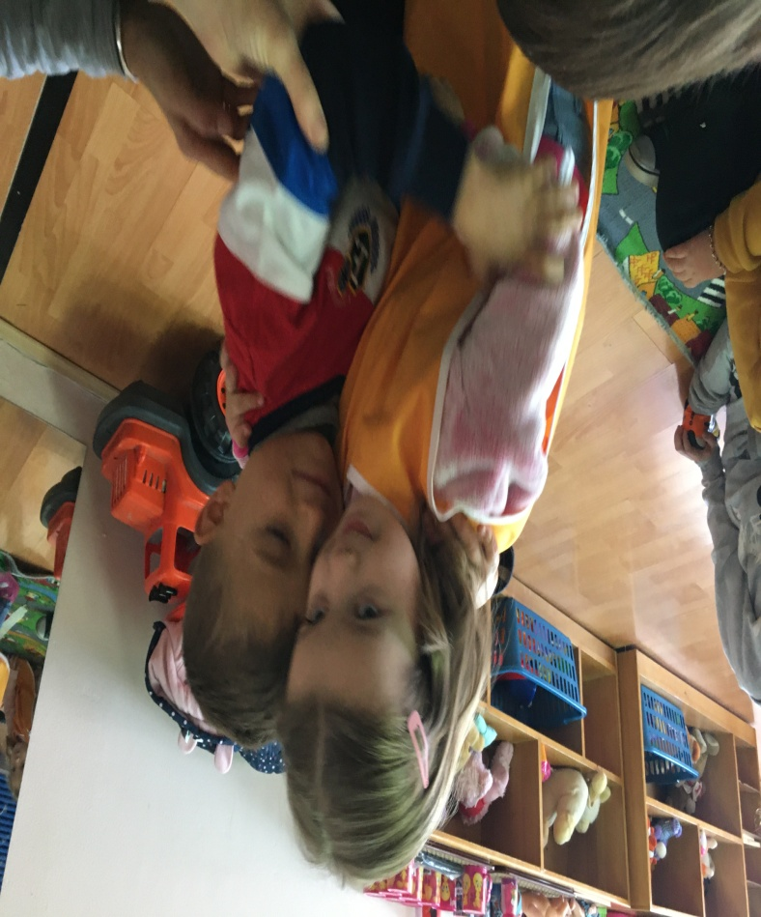
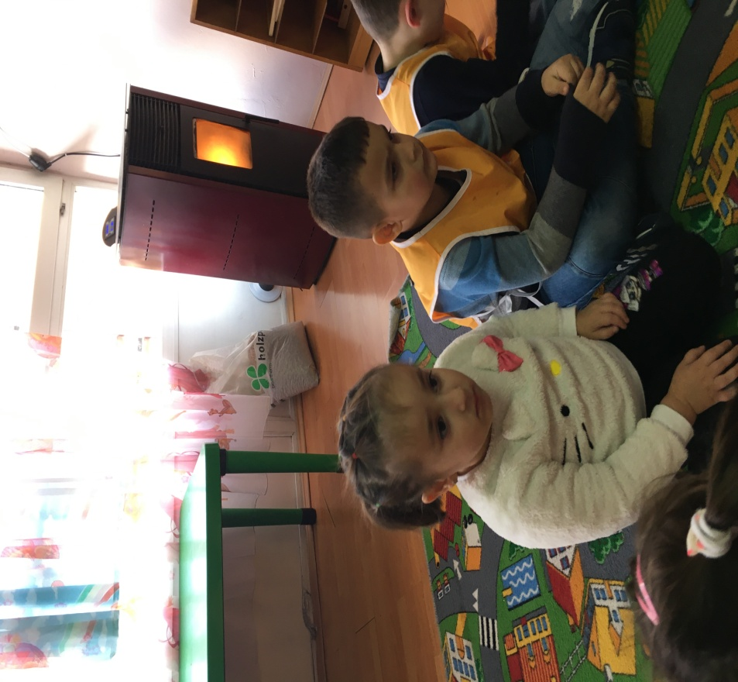
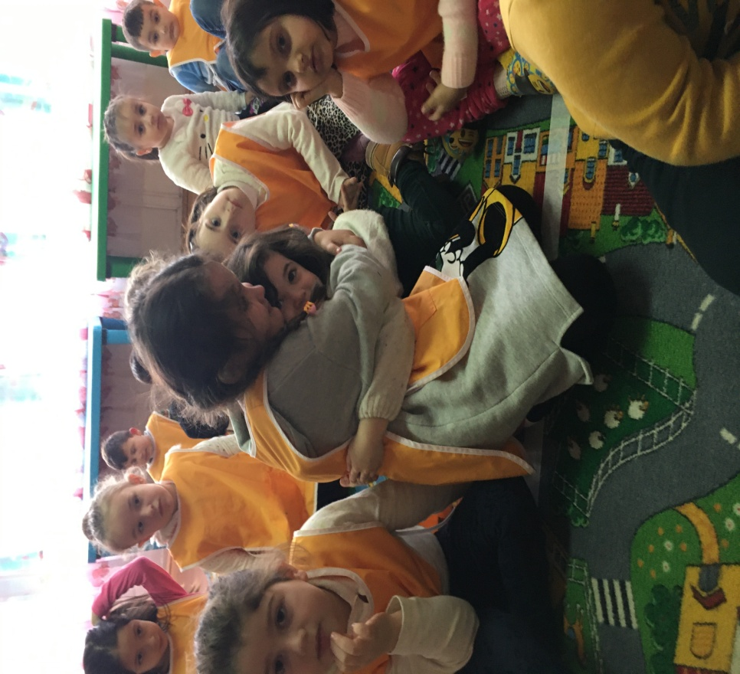
Let’s share our games
2019-1-BG01-KA201-062605
Fatima, Rubin and Eva’s cousins

Slide 8
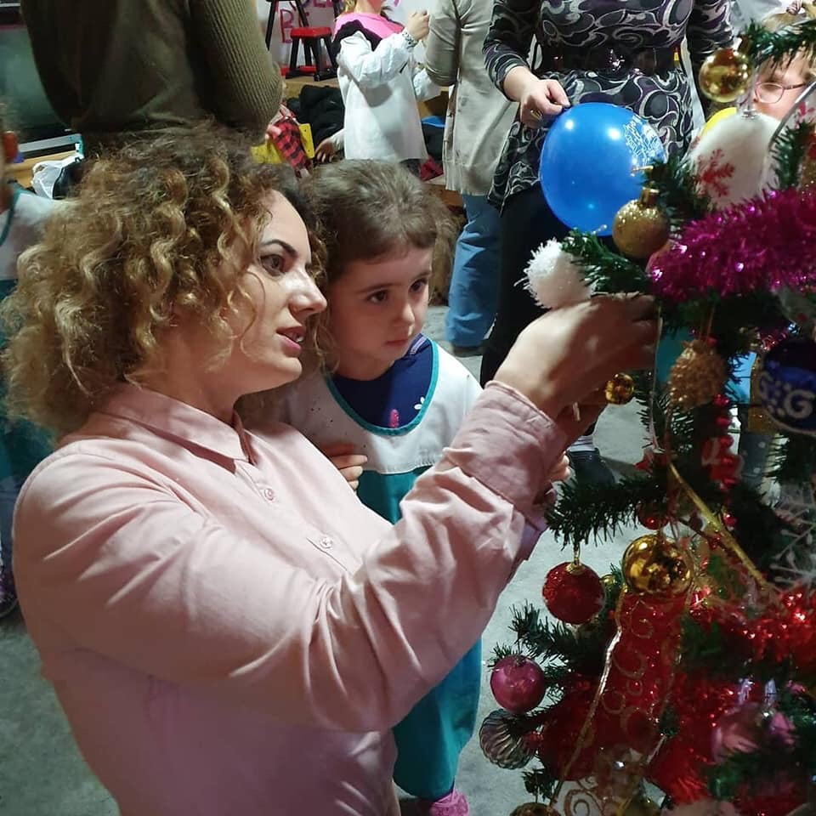
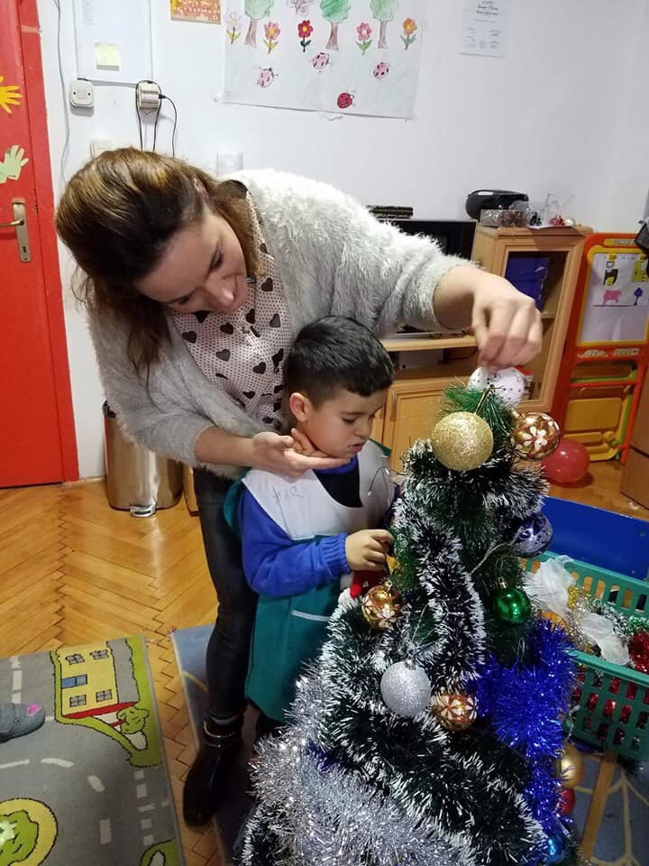
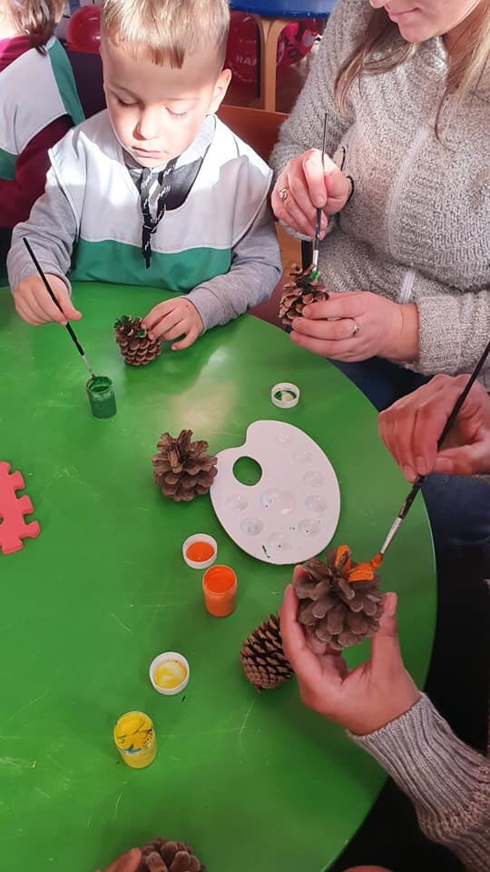
Let’s share our games
2019-1-BG01-KA201-062605
Decorating the classroom for the New Year 2020

Slide 9
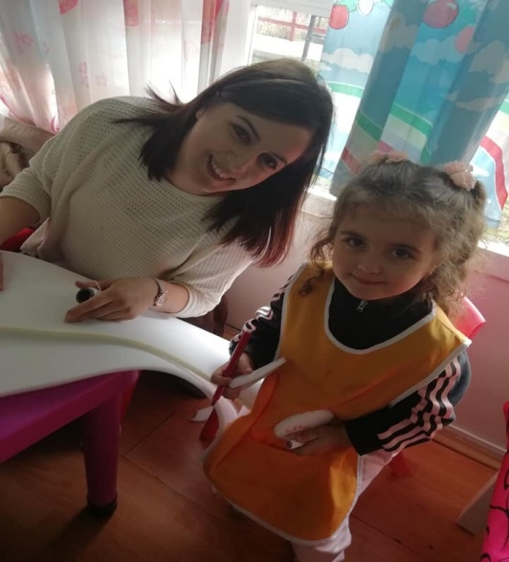
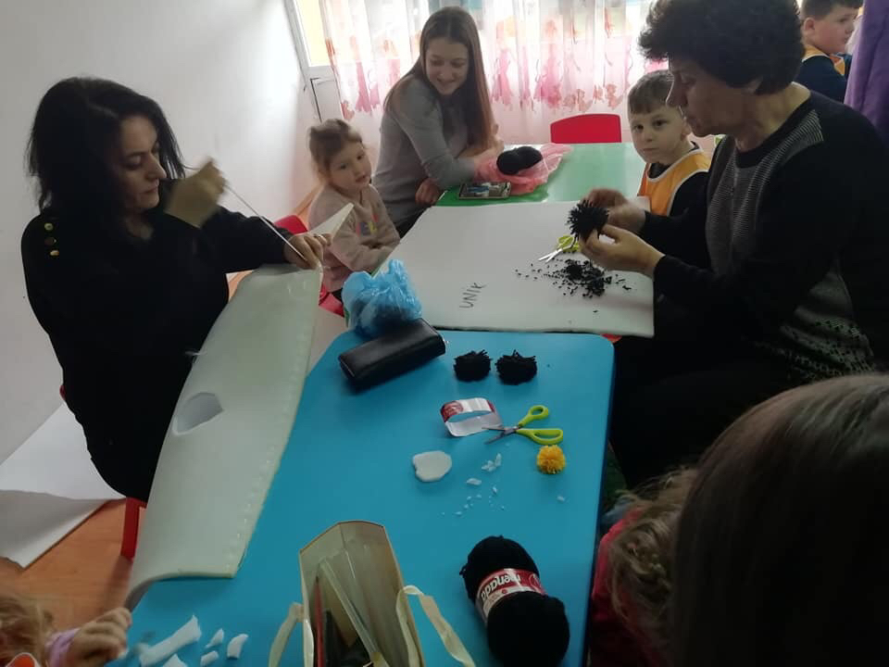
Let’s share our games
2019 – 1 – BG01 _ KA201 - 062605
Preparation of clothes for the celebration of the New Year 2020

Slide 10
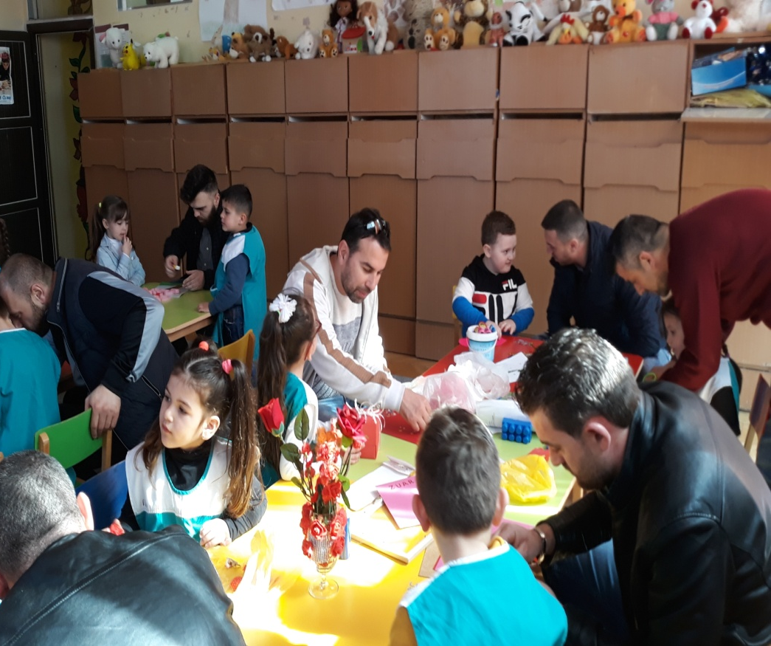
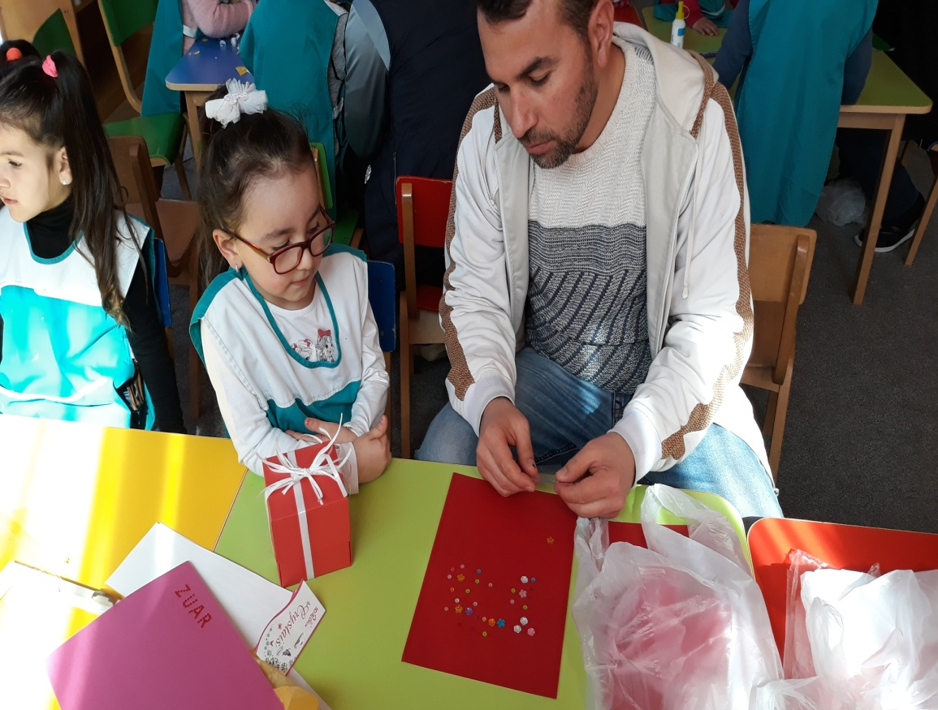
Let’s share our games
2019-1-BG01-KA201-062605
8 March – Women’s day (gifts made by fathers and children for mothers

Slide 11
Let’s share our games
2019-1-BG01-KA201-062605
Thank you for your attention!
www.breshia.net

