Slide 1
JOUDG “BRESHIA” DEBAR - NORTH MACEDONIA www.breshia.net

Slide 2
Education status in our country
In our country education status is in level and works very well. The parents are satisfied from educators and by the way the child reflects on himself acquired knowledge.
The activities inside and outside in the kindergarten space held regularly where we used differently materials and in children develop the imagination, creativity and areas development (motor development, socio-emotional and cognitive).
With this project MY TEACHER: NATURE, we progress too much that activities to be realized outside and with natural materials.

Slide 3
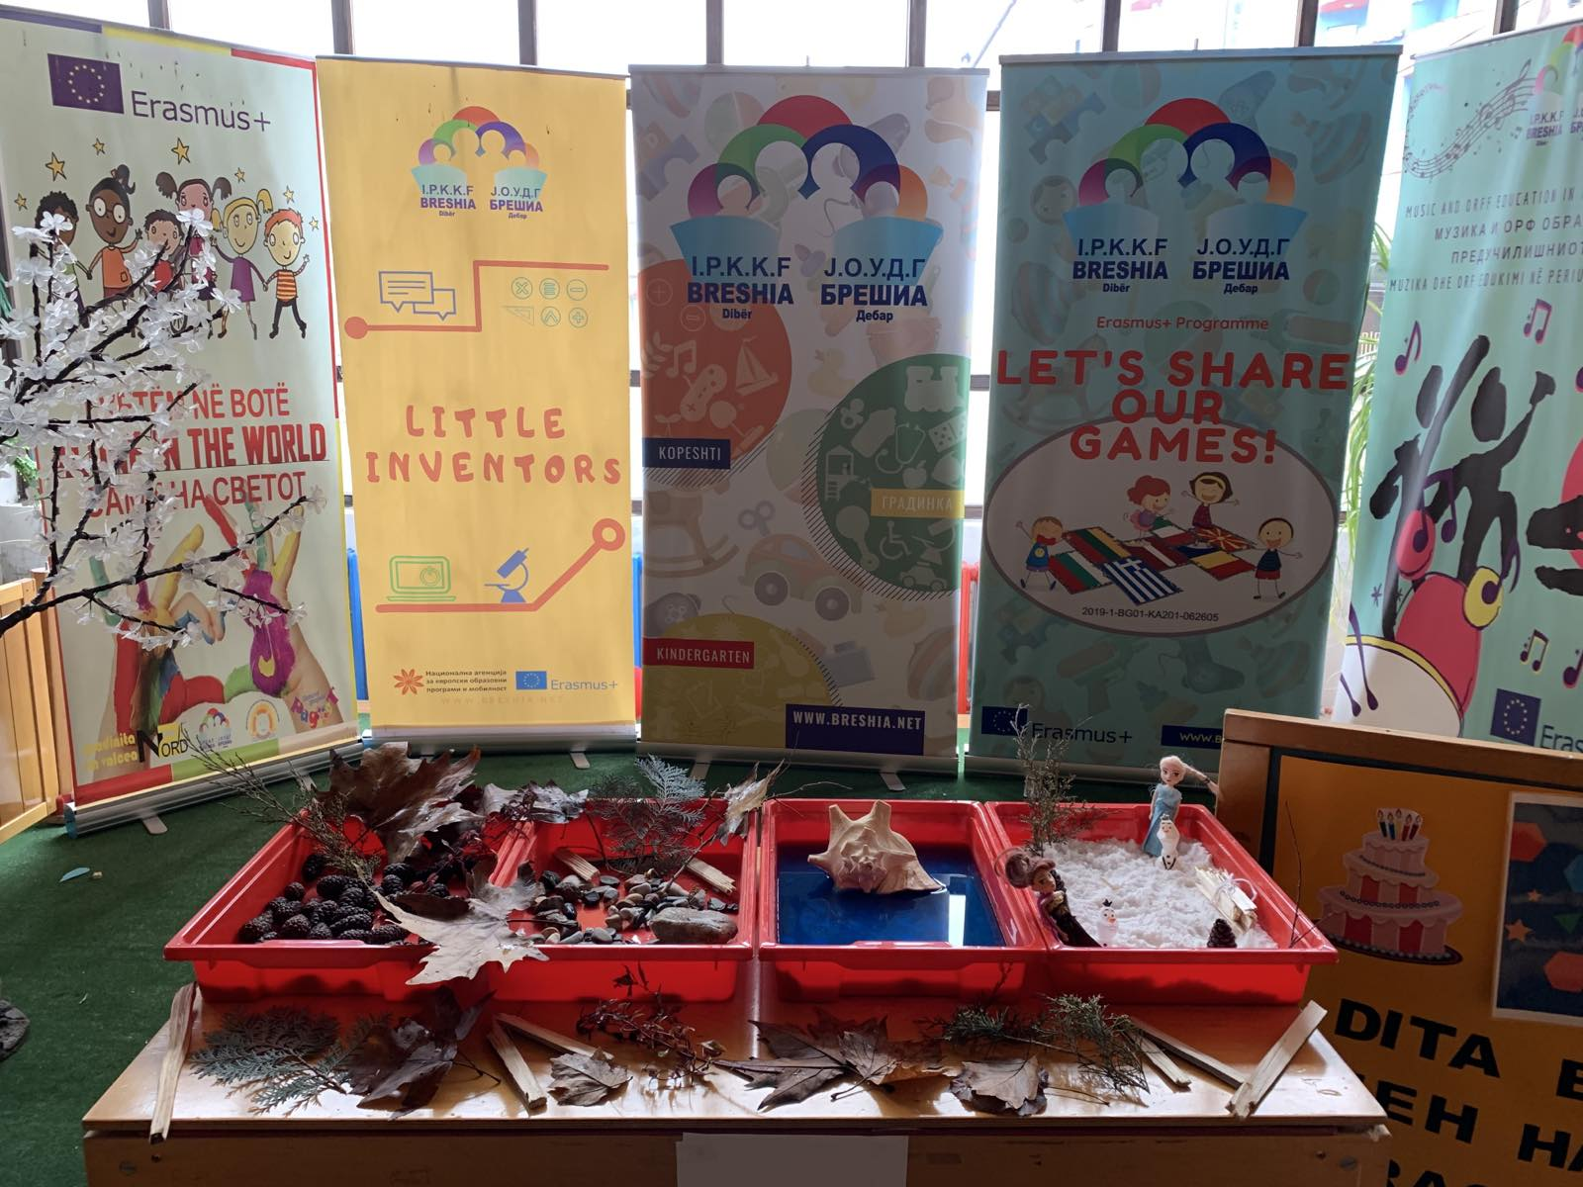
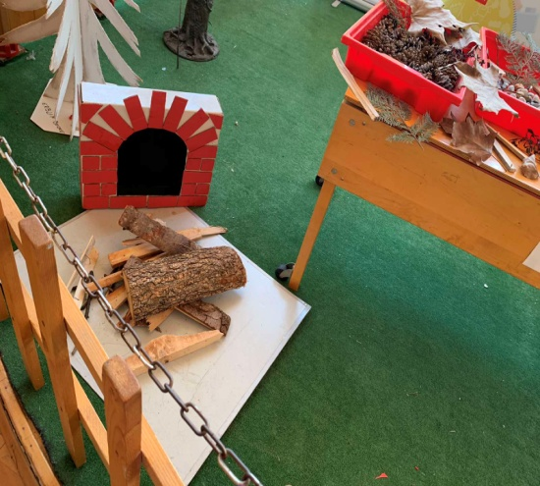
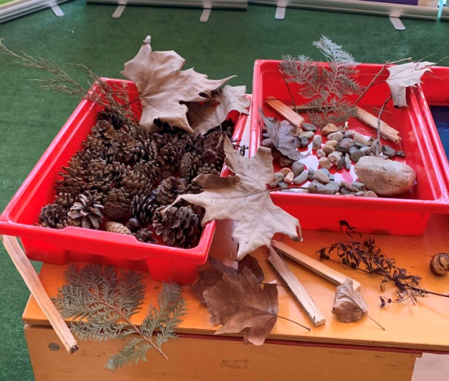
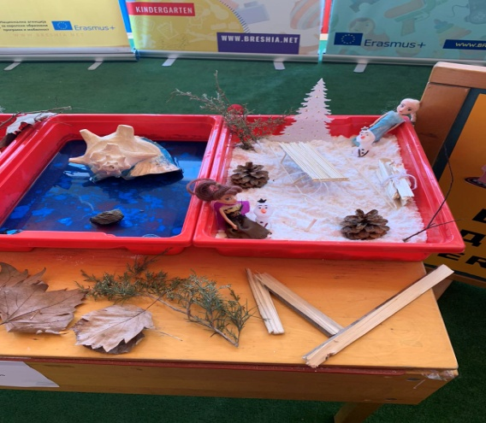
Science Fair in kindergarten JOUDG “Breshia” - Debar

Slide 4
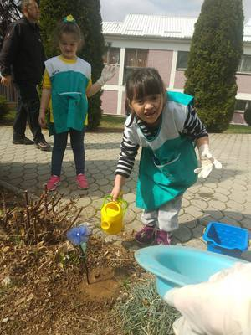
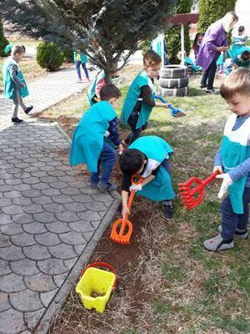
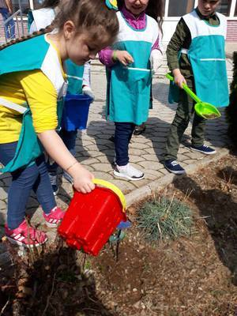
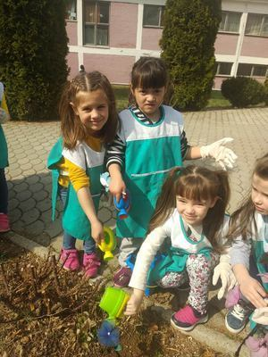
Module: Science with Natural Materials In the garden of Breshia

Slide 5
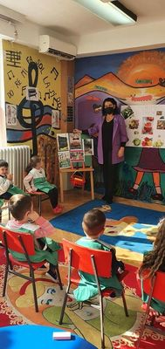
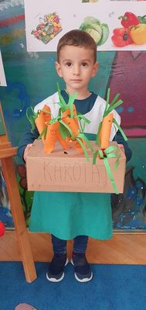
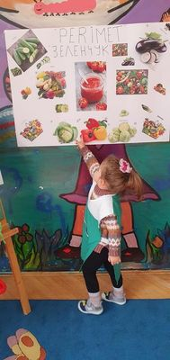
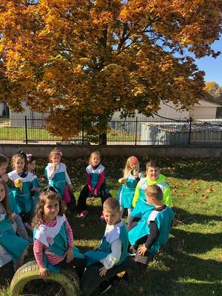
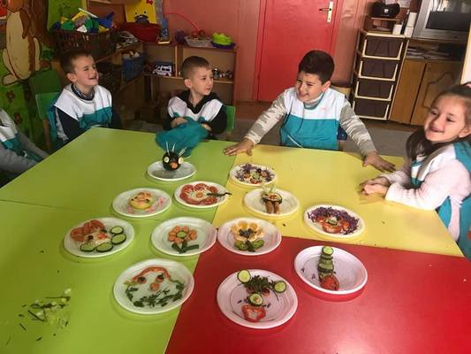
Autumn is coming in our Kindergarten

Slide 6
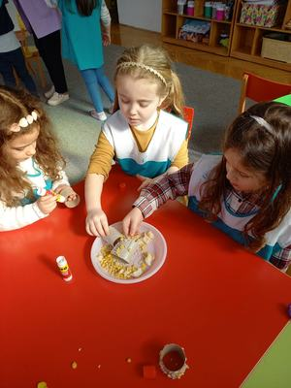
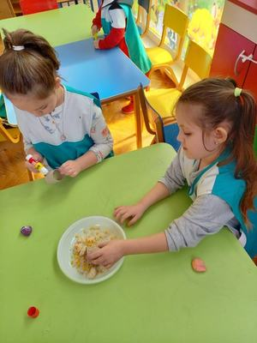
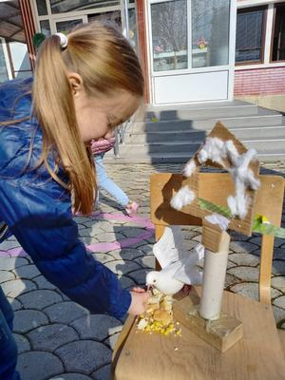
Module: Art of Nature Food for birds in the winter

Slide 7
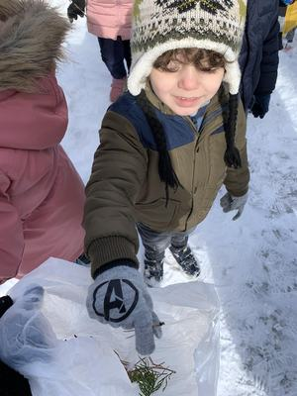
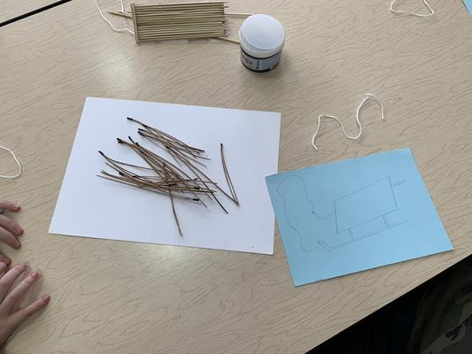
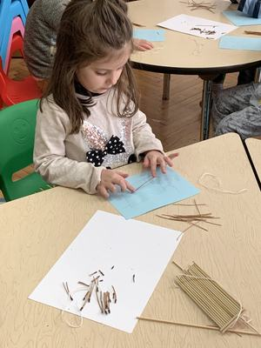
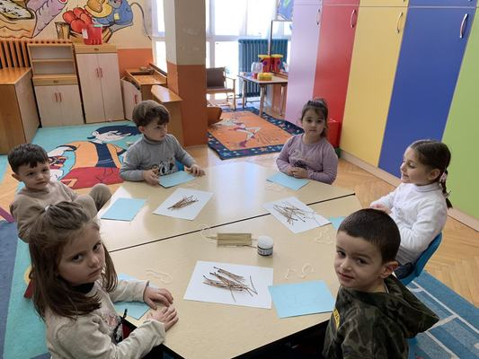
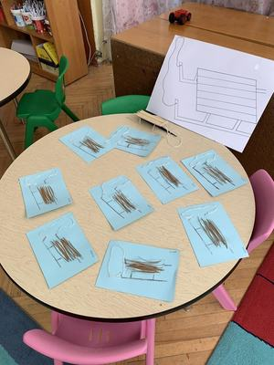
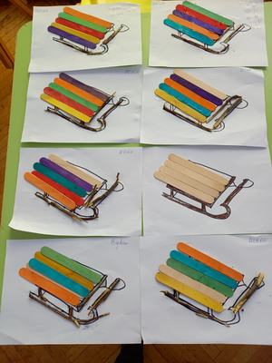
Artistic ideas with the tree

Slide 8
All activities can be found at eTwinning platform:
https://twinspace.etwinning.net/107360/pages/page/1099359

