Slide 1
Children and accidents

Slide 2
We have all learned first aid.
Some more, some less
It's not always easy.
If a person does not work in medicine on a daily basis, it is very difficult to predict what his or her behavior will be at the scene of the accident.
A panicked person cannot always remember what needs to be done.

Slide 3
Children and accidents
Children can also panic in the event of an accident
It is very important to role-play different situations with children
In teaching children, we must not forget that they are not able to do and learn all we can.
When we teach children first aid techniques, we cannot expect them to behave like experienced adults.
There are many first aid techniques that we can do ourselves but that it do not make sense to teach to young children.
If we make first aid education too difficult, children will lose the will to learn it because they will feel that they cannot cope.
Our goal is to compile teaching materials for teaching children up to the age of seven.

Slide 4
Emotional shock
Did I do it right?
What did I not do?
Would the victim have survived if I hadn´t touched them?
If I had done this before and then that, would it have been different?
1-2 weeks after the accident, hesitations and fears are natural.
If the anxiety does not decrease within 2-3 weeks, a psychologist should be consulted.
A similar need may arise in a child.
If a child cannot talk about the phenomenon and does not receive answers to his or her questions, the situation can be frustrating for years.

Slide 5
Algorithmic learning
Algorithmic learning creates specific lines of command for children that make it easier for them to behave.
What were the key issues when it comes to accident prevention?
What happened here?
Why did this accident happen?
What could have been done to prevent this accident?
What do we need to do now that the accident has happened?

Slide 6
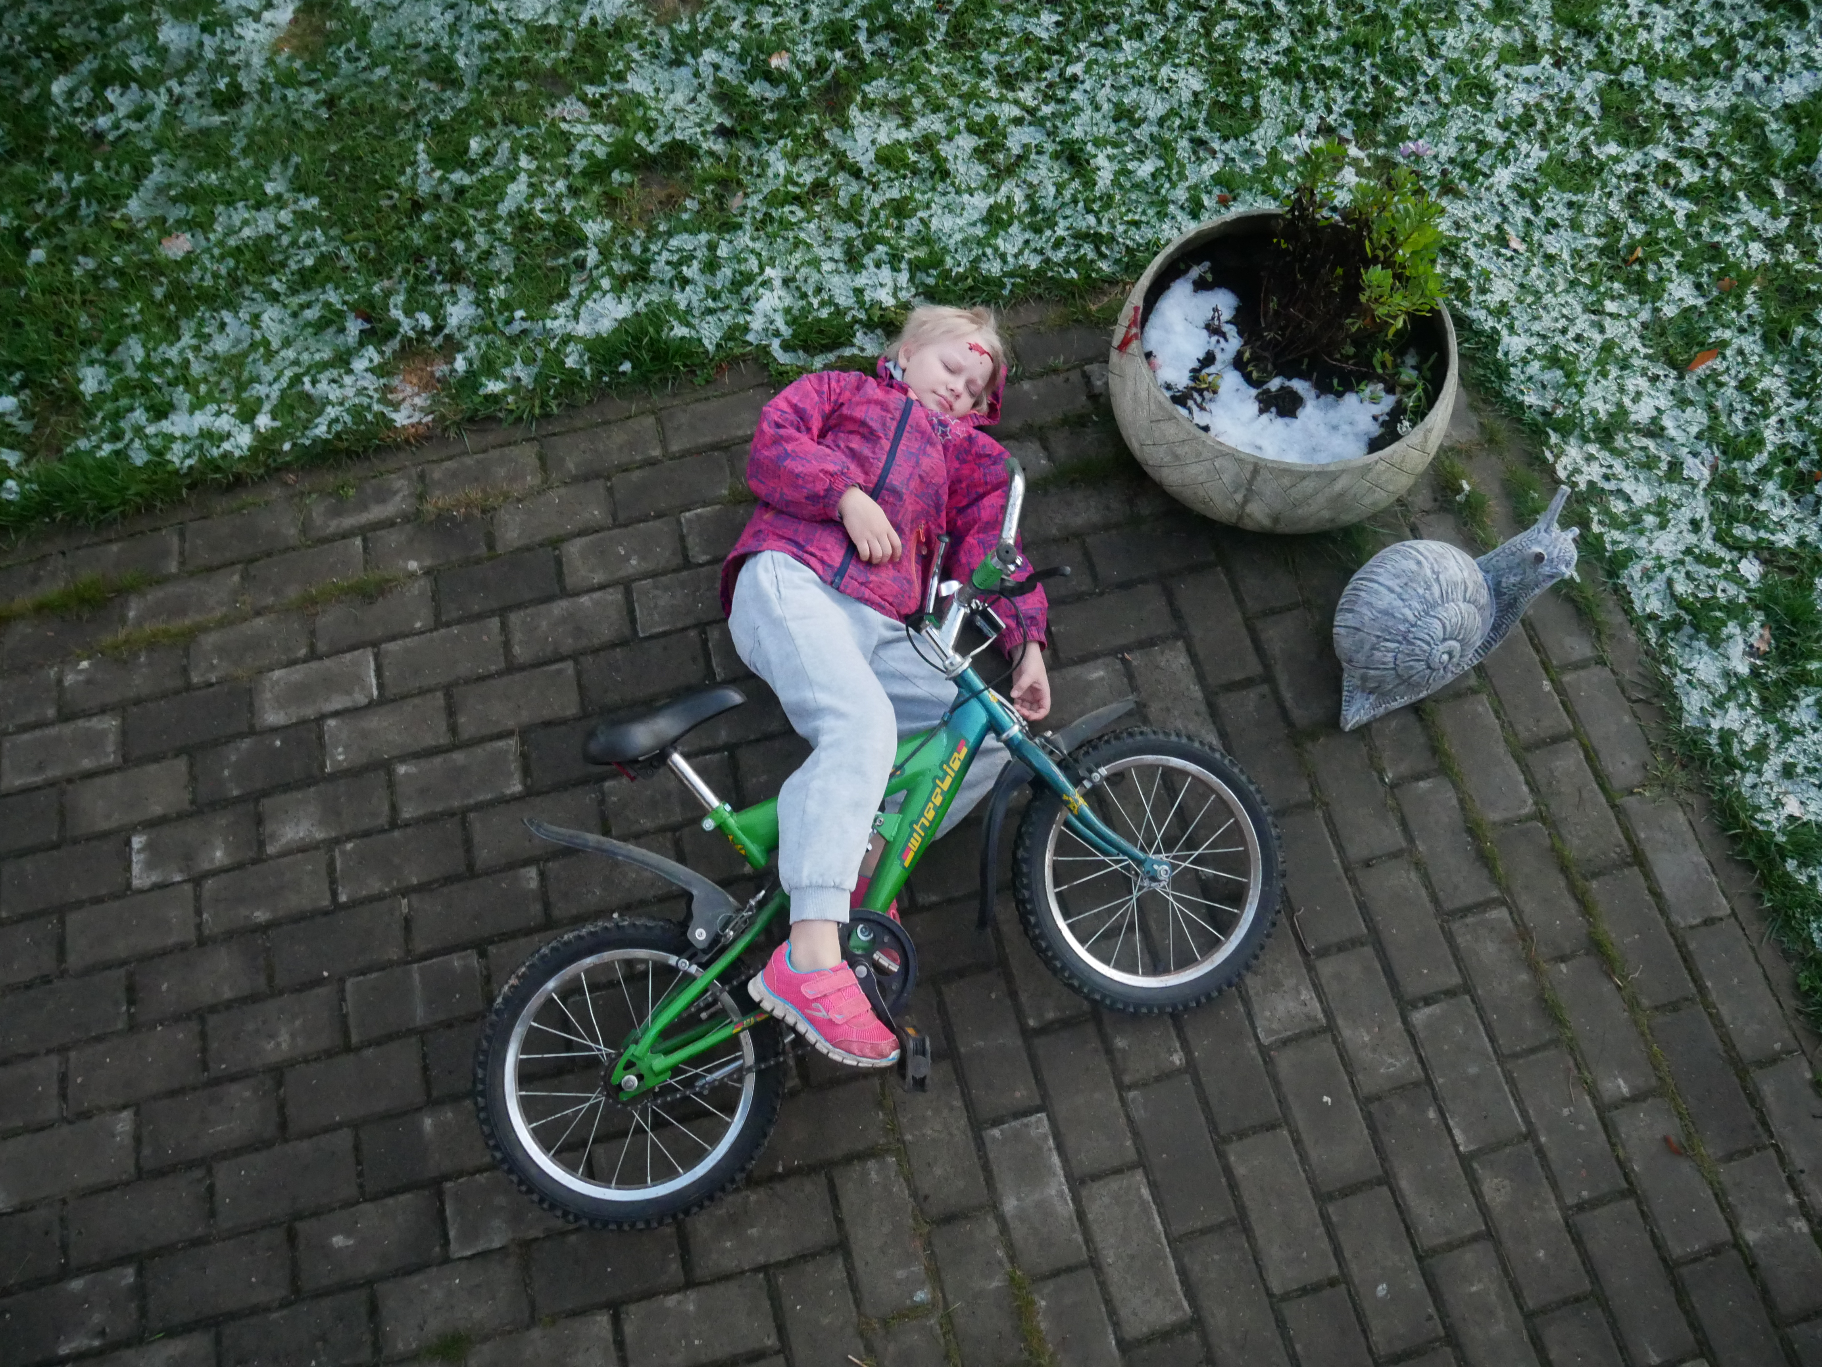
Bicycle accident

Slide 7
Bicycle accident
1. What happened here?
The girl went for a bike ride. He rode his bike against the flowerpot
and broke his head.
2. Why did this accident happen?
He broke his head because he didn't have a helmet on his head.
3. What could have been done to prevent this accident?
Had he had a helmet on his head, he would not have injured his head. That is why it is very important to always wear a helmet when riding a bicycle.
4. What do we need to do now that the accident has happened?
…..

Slide 8
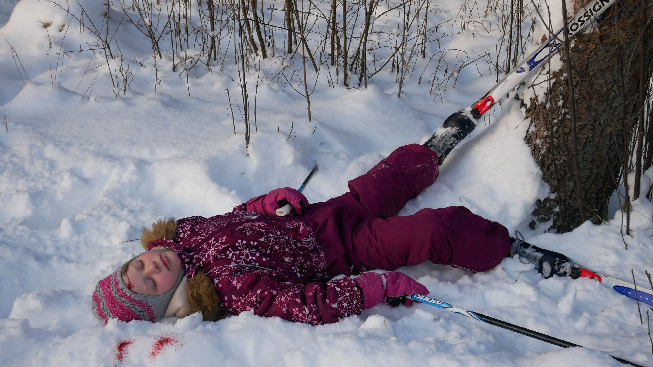
Ski accident

Slide 9
Ski accident
1. What happened here?
The little girl went skiing, lost her balance and rode against the trees.
2. Why did this accident happen?
The road was slippery, the girl could not ski well and lost her balance.
3. What could have been done to prevent this accident?
Accidents cannot always be prevented, sometimes they just happen. However, if an accident has happened, we must definitely try to help.
4. What do we need to do now that the accident has happened?
……

