Slide 1
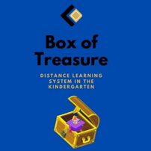
Testing distance learning, methodology and improving
JOUDG “Breshia”

Slide 2
Digital education in preschool introduction
Digital technologies are an integral part of children’s lives in the 21st century. Children spend more time in the digital environment than ever before and at younger ages.
These technologies are having such a profound effect on all aspects of people’s lives that they are now becoming taken-for-granted.
That is why as much as it is the right of young children to become literate, they should also become proficient users of ICT through the effective development of ICT capability in preschool activities.
Digital technologies are already part of children’s lives. A growing role of the education system is to support children to understand and make the most of the technologies they encounter.

Slide 3
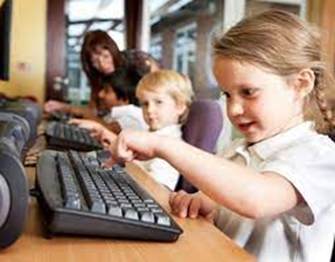
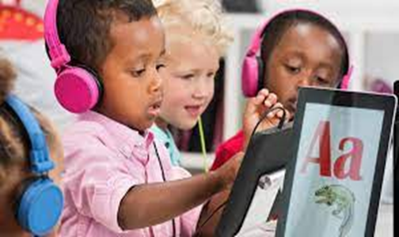
Technology cannot and should not replace human interaction or relationships or take the place of activities such as reading stories together or sharing conversations with children. Properly used, however, computers and software can serve as catalysts for social interaction and conversations related to children's work.
Strategies to build socialization into computer use include placing two seats in front of the computer to encourage children to work together, placing computers close to each other to facilitate sharing ideas, and locating computers in a central spot to invite , other children to participate in the activity

Slide 4
Distance education is a method of education in which the learner is physically separated from the teacher and the institution sponsoring the instruction
The contract between teacher and learner, requires that the student be taught, assessed, given guidance and, where appropriate, prepared for examinations that may or may not be conducted by the institution. This must be accomplished by two-way communication
What is Distance Learning?

Slide 5
The use of various forms of electronic media increases time effectiveness and improves the delivery of information. Video, audio, and computer-based applications may enhance the product received by the independent learner.
Teachers and students can interact through both two-way video and one-way video with two-way audio systems
Forms of distance learnings

Slide 6
How to make a distance learning in preschool
Let children guide you: Although we’re not together, children are still playing, exploring, and learning in their homes. During the small-group meetings, we display these photos or videos so children’s voices are heard and teachers are not the only leaders of remote discussions.
Create Equity for Distance Learners: Encourage the school to provide students in need with laptops, tablets, and hot spots, Provide off-line learning options by giving multiple options for communicating. Making sure technologies are mobile friendly.

Slide 7
Connect Children with Independent Learning Tools- As distance learning progresses, students’ needs will become more apparent. Some will need extra help. Others will need enrichment to stay engaged. Fortunately, so many organizations and corporations have stepped up to offer resources to help. Here are some great websites for children, whether they need assistance with writing, tutoring, or opportunities to pursue their interests:
Khan Academy
National Geographic Kids
Cool Math
ABCmouse
Skillshare
TED-Ed
Google Earth

Slide 8
Maintain Live Connections During Distance Learning-It’s important that educators maintain as much of a connection with their children as possible. That can’t be accomplished through prerecorded lessons or interactive worksheets. There’s simply no replacement for live interactions. These help students connect to one another and their instructors.
Provide meaningful alternatives to screen time- Children between the ages of 2 and 7 are still in the preoperational stage, and it is developmentally inappropriate to expect their learning to be entirely screen-based

Slide 9
Music is magical: Children respond well to singing and dancing online. For a child, participating in a song or dance is an easy way to engage with a screen because they can follow the leader
Be kind to yourself: Measure your success in participation and smiles. If children are disinterested during a virtual meeting, remember that they are young and this is new to everyone. Don’t take abrupt exits personally. If overall attendance is dwindling, call or survey families to find out what they need and try your best to adapt

Slide 10
Conclusion
Given the right tools and support, children can thrive during distance learning. However, it does take an effort to ensure that children have what they need to succeed. When instructors are sensitive to potential difficulties, work to ensure they make connections, and use the many tools available, they are best able to help students adjust to this new reality.

Slide 11
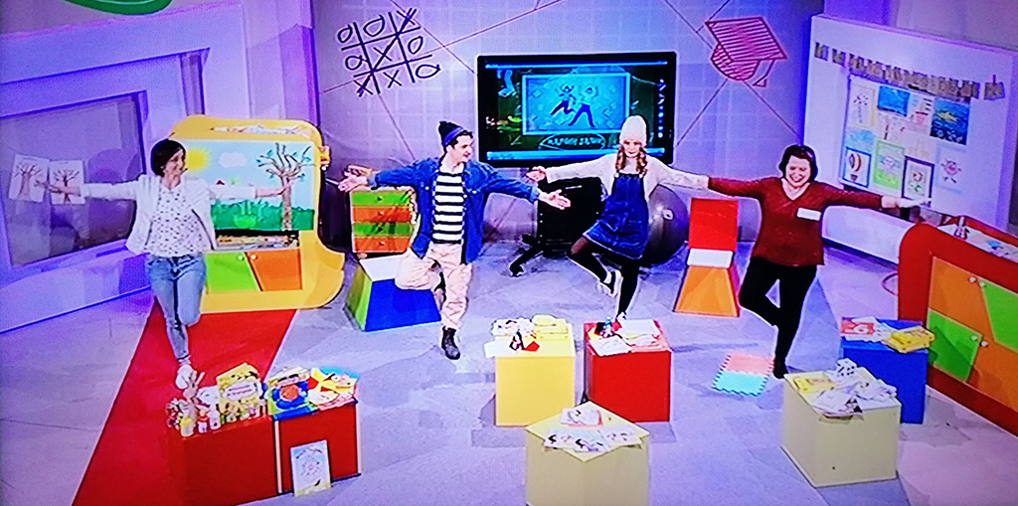
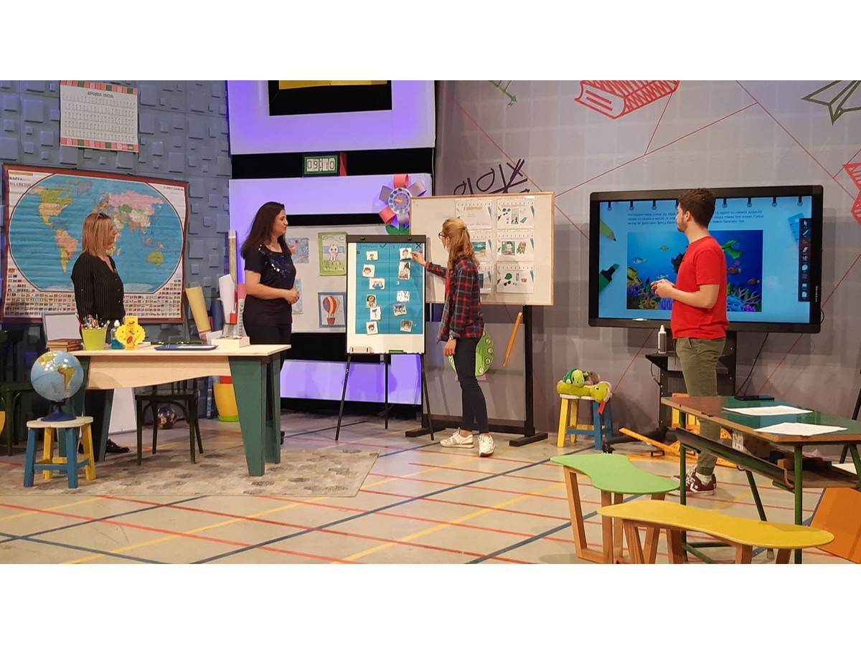
Testing the distance learning in North Macedonia
With the help of the national television MRTV, Ministry of Labor an Social Politics and Ministry of Education and Science, еvery morning between 9-11 am the program for pre-school and primary school children is broadcast.

Slide 12
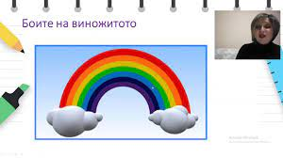
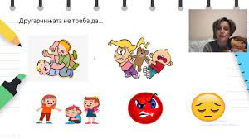
E-classroom-The video activities prepared by educators from all over the country and offer the opportunity for fun, play, teaching and a new experience for the children
https://www.youtube.com/watch?v=dG7BWknr6es
https://www.youtube.com/watch?v=BrT3DNvUUX4
https://www.youtube.com/watch?v=dN7sqVe9f2A

Slide 13
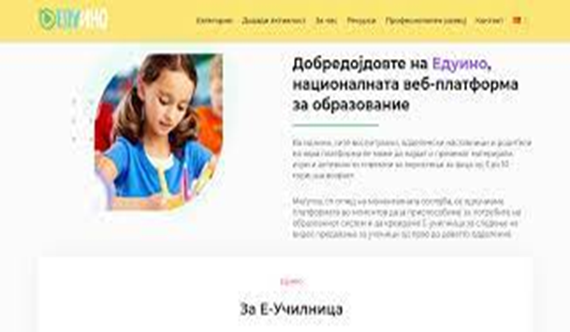
EDUINO Early Childhood Development is an educational platform for educators, teachers and parents. The platform contains quality and verified educational materials, games and activities for children of preschool age and grade school, ie from 3 to 10 years, in order to encourage socio-emotional development and learning based on play.
eduino.gov.mk

Slide 14
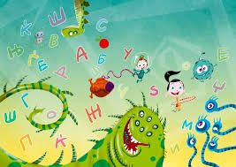
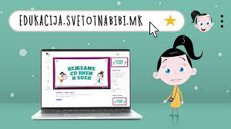
Bibi’s world-the educational platform of through which the children are able to reward their knowledge through an interactive approach and a program prepared by leading educational specialists from the country.

Slide 15
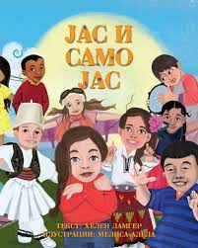
"Think Equal": Online picture books being introduced in kindergartens through the UNICEF supported and UK Government funded programme which is helping to build social-emotional skills in pre-school aged children: empathy, kindness, self-esteem, perseverance, critical thinking, conflict resolution, self-esteem, communication, self-awareness and more. https://issuu.com/unicefmk

Slide 16
Outcomes
Teachers
Children
Parents
Exchange of experiences between educators
The educators develop their digital skills
Develop new method of working with the children
Professionally develop and upgrade their knowledge and skills
Encouraging socio-emotional skills in children.
developed cognitive skills through the use of digital tools
They use technology for educational purposes
Quality time spent with their children
Getting acquainted of our work
The parent-child-educator relationship is strengthened

Slide 17
Time for discussion…….

Slide 18
Thanks for your attention

