Slide 1
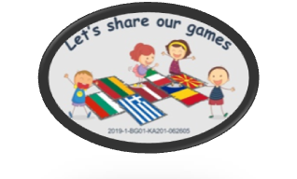
Project: Let's share our games
Project no: 2019-1-BG01-KA201-062605
Topic: Creativity with recycled materials

Slide 2
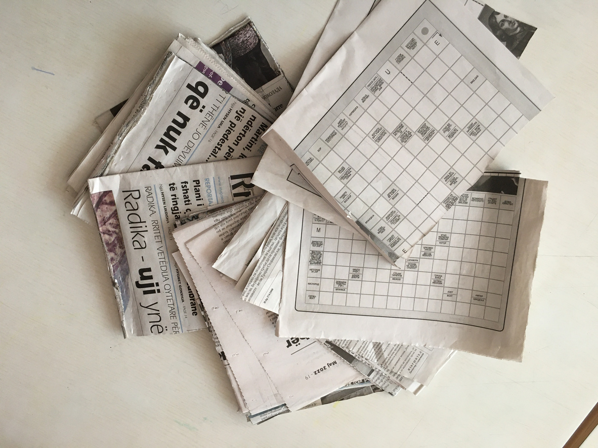
Project: Let's share our games
Project no: 2019-1-BG01-KA201-062605
We recycle old newspaper
- The teacher cuts the newspapers with scissors into 4 parts, in the shape of a rectangle.

Slide 3
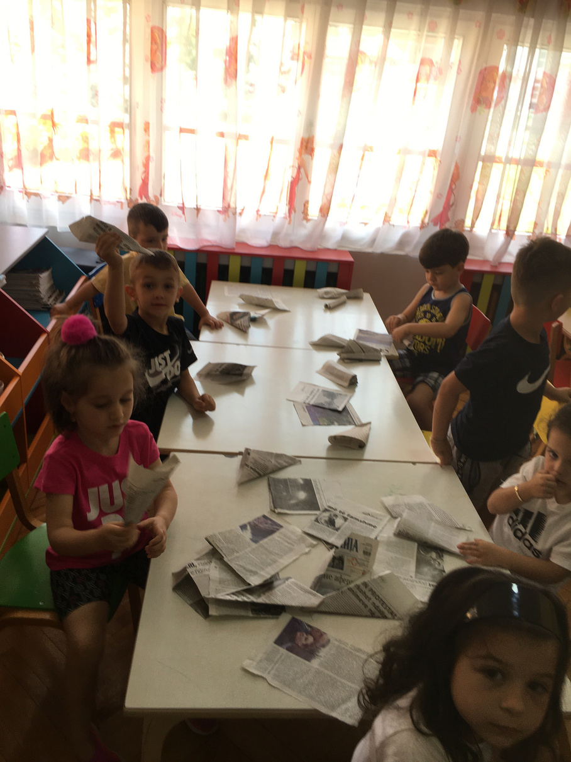
Project: Let's share our games
Project no: 2019-1-BG01-KA201-062605
Then, the teacher distributes the cut-out newspapers in the shape of a rectangle, to the children.

Slide 4
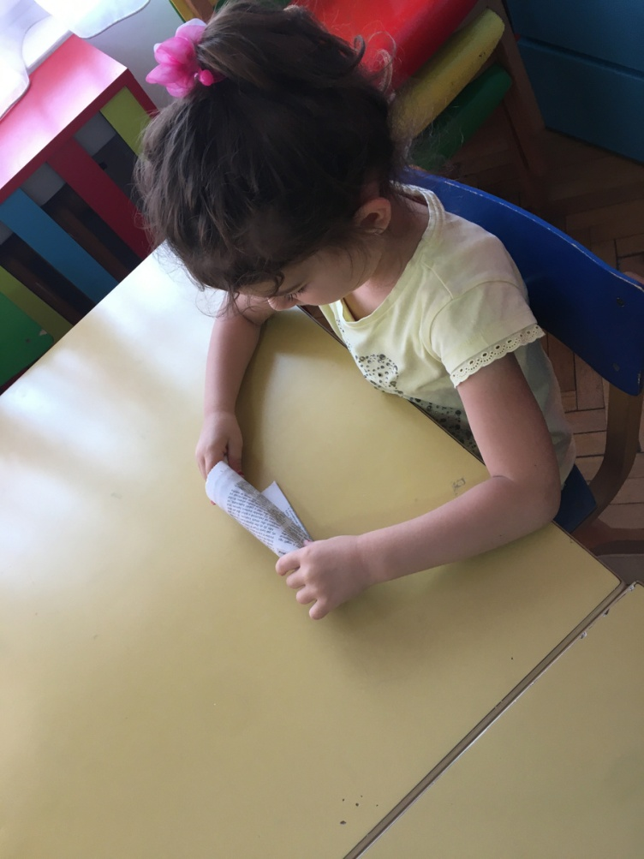
Project: Let's share our games
Project no: 2019-1-BG01-KA201-062605
The children turn the paper like an ice cream cartridge.

Slide 5
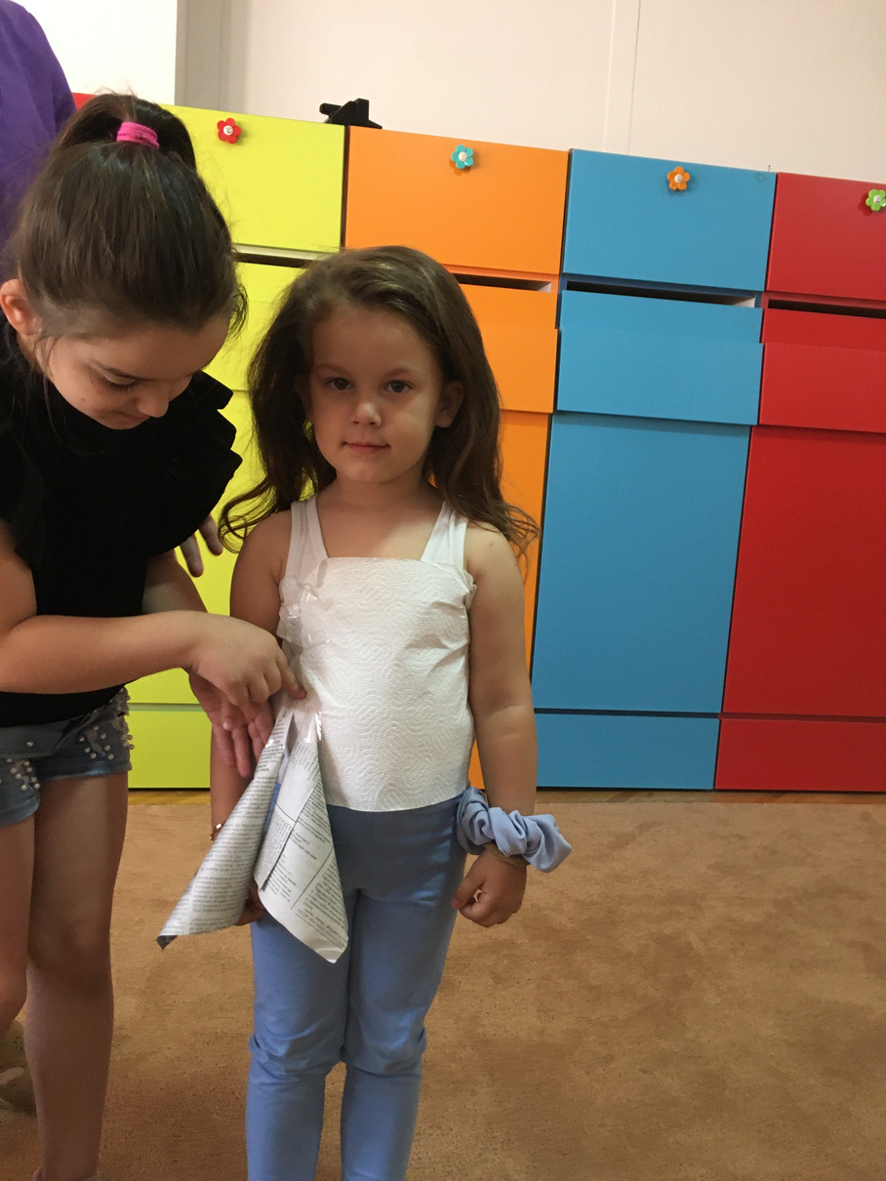
Project: Let's share our games
Project no: 2019-1-BG01-KA201-062605
And...on the upper part of the body of a child (girl) we put toilet paper and glue it.

Slide 6
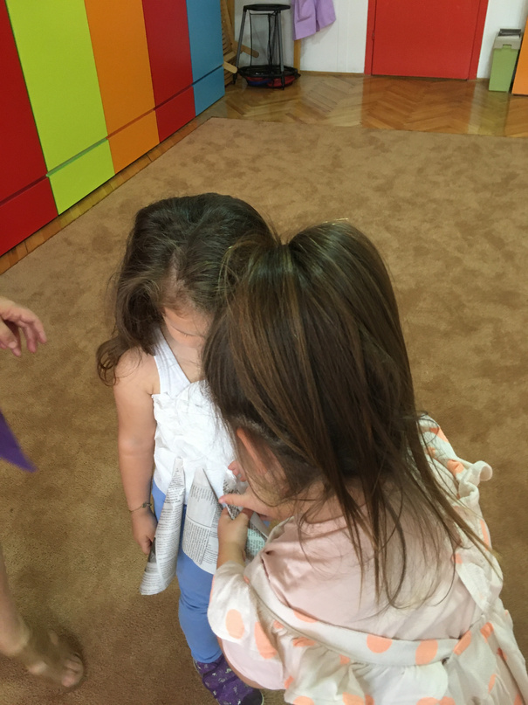
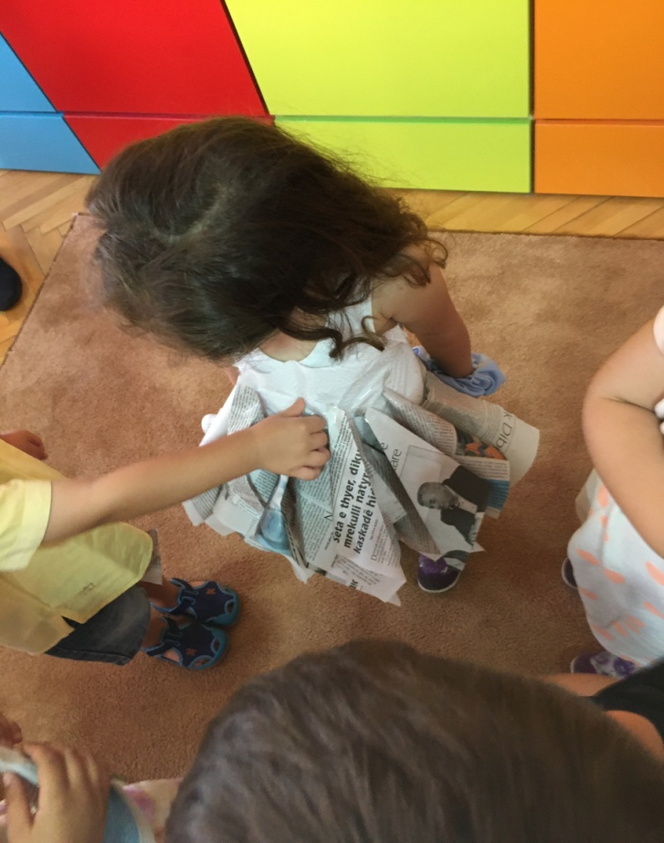
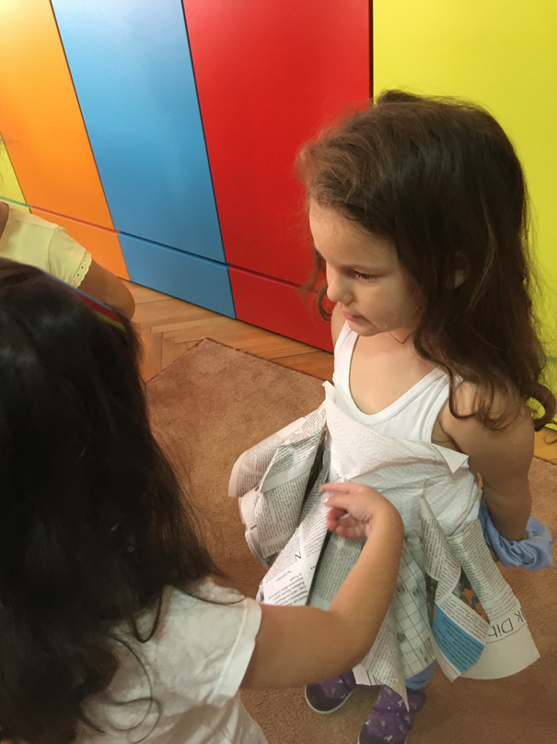
Project: Let's share our games
Project no: 2019-1-BG01-KA201-062605
The cartridges that the children make, one by one they glue them to the toilet paper that the girl has in her body.

Slide 7
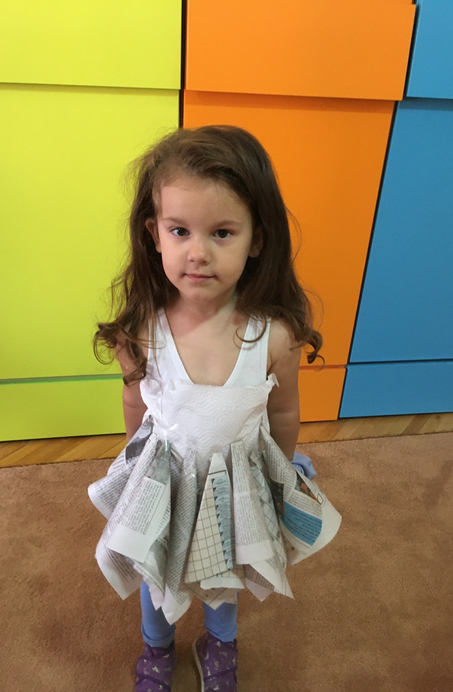
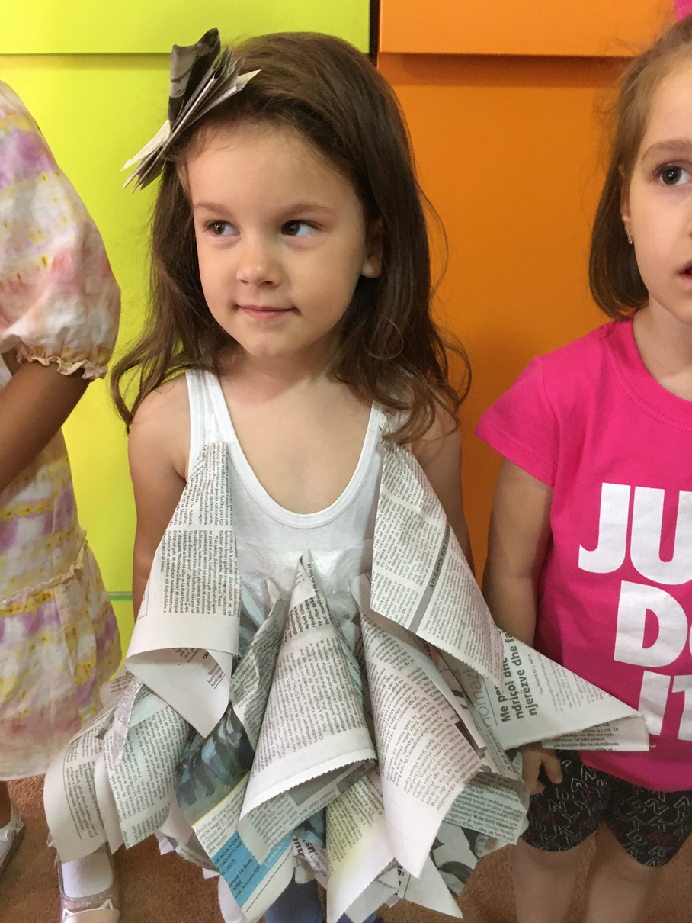
Project: Let's share our games
Project no: 2019-1-BG01-KA201-062605
And, what they have done?!!!
Dress for girl

Slide 8
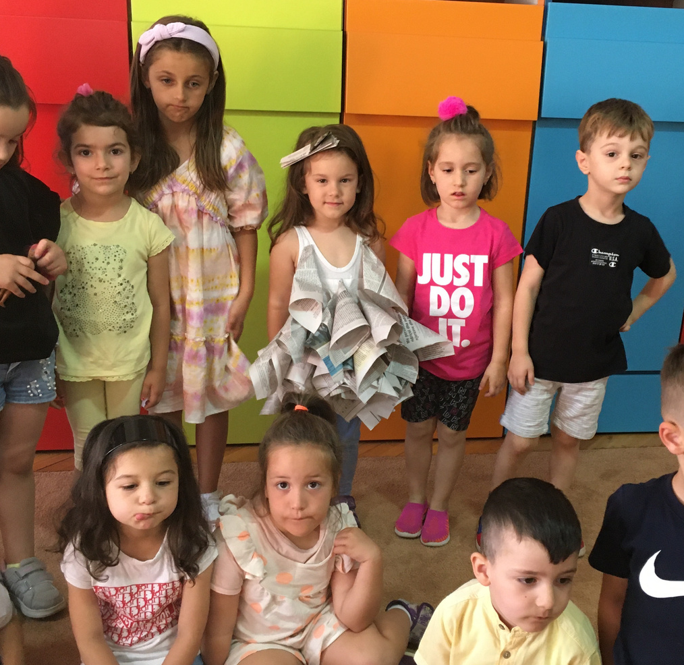
Project: Let's share our games
Project no: 2019-1-BG01-KA201-062605
Dresses from friends!

