Slide 1
Montessori in preschool period
Project number: 2020-1-TR01-KA229-092143

Slide 2
Montessori in preschool period
Project number: 2020-1-TR01-KA229-092143
Montessori activities
Cosmic education

Slide 3
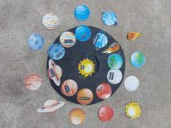
Montessori in preschool period
Project number: 2020-1-TR01-KA229-092143
Identification
- Planets are drawn on a circular card, while the same planets are also cut on small cards. Place the cut planet in the place where the same planet is on the black cardboard.

Slide 4
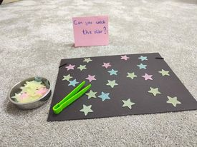
Montessori in preschool period
Project number: 2020-1-TR01-KA229-092143
Can you catch the stars?
- Several stars are placed in a space. The child must catch the stars with the clip and put them in the bowl.

Slide 5
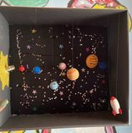
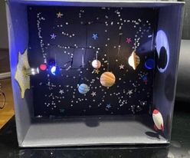
Montessori in preschool period
Project number: 2020-1-TR01-KA229-092143
Night or day?
The planets are hanging in a box. With a lamp, we can see what color the planets are by turning on the lamp.

Slide 6
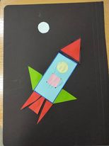
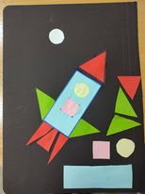
Montessori in preschool period
Project number: 2020-1-TR01-KA229-092143
Find the right place!
In one photo a rocket is drawn, while in the other we have the same rocket drawn but also other parts. Found the right place for the parts that are detached from the rocket.

Slide 7
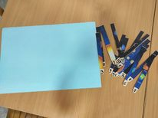
Montessori in preschool period
Project number: 2020-1-TR01-KA229-092143
Arrange by numbers!
The planets are on a laminated sheet. The sheet is divided into fifteen parts. Sticks with numbers are attached to the back of the paper. Arrange the separated parts according to the numbers.

Slide 8
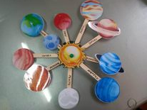
Montessori in preschool period
Project number: 2020-1-TR01-KA229-092143
Which planet is closest to the sun?
The sun is located in the middle, while the planets are located on the side of the sun. The child must distinguish which planet is closer to the sun and which is further away.

Slide 9
THANK YOU FOR YOUR ATTENTION!

