Slide 1
Montessori in preschool period
Project number: 2020-1-TR01-KA229-092143

Slide 2
Montessori in preschool period
Project number: 2020-1-TR01-KA229-092143
Montessori activities
Language

Slide 3
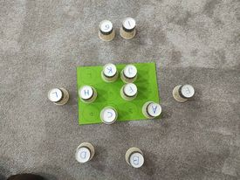
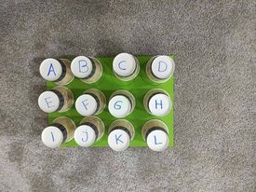
Montessori in preschool period
Project number: 2020-1-TR01-KA229-092143
Learning the alphabet
Some of the letters of the alphabet are written on a cardboard, while the letters of the alphabet are also written on the cardboard cups. Place the correct glass on the correct letter.

Slide 4
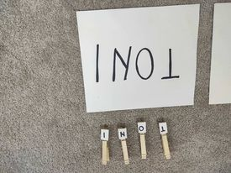
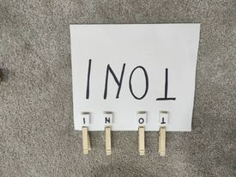
Montessori in preschool period
Project number: 2020-1-TR01-KA229-092143
We learn the names of our friends
The names of the friends are written on the sheets, while a letter is written on each clothspins. Put the correct letter on the sheet with name in the appropriate place.

Slide 5
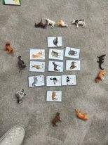
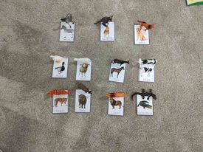
Montessori in preschool period
Project number: 2020-1-TR01-KA229-092143
We learn the names of animals
Various animals are drawn on the laminated sheets, while the animals are on the sides. Place the correct animal on the same animal that is on the sheet.

Slide 6
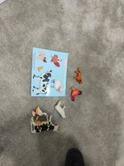
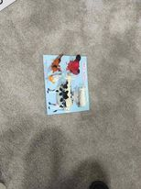
Montessori in preschool period
Project number: 2020-1-TR01-KA229-092143
Which one is bigger?
Animals, big and small, are drawn on the paper. Name which animal is big and which is small, and put it in the right place.

Slide 7
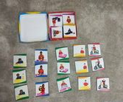
Montessori in preschool period
Project number: 2020-1-TR01-KA229-092143
Sequence pictures
- In the box there are several photos, three of which show the same event. Find the pictures, sort them according to the event and tell what the boy or girl is doing in the picture.

Slide 8
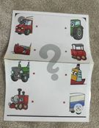
Montessori in preschool period
Project number: 2020-1-TR01-KA229-092143
Combine the parts
Several means of transport are drawn on the laminated sheet. Connect the front part with the back part of the means of transport with a felt-tip pen.

Slide 9
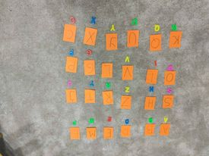
Montessori in preschool period
Project number: 2020-1-TR01-KA229-092143
Alphabet
All the letters of the alphabet are written on small sheets. Put the letter from the plastic to the right place on the letter on the paper.

Slide 10
THANK YOU FOR YOUR ATTENTION!

