Slide 1
Montessori in preschool period
Project number: 2020-1-TR01-KA229-092143

Slide 2
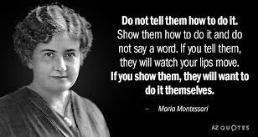
Montessori in preschool period
Project number: 2020-1-TR01-KA229-092143
Montessori activities
Mathematics

Slide 3
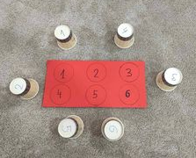
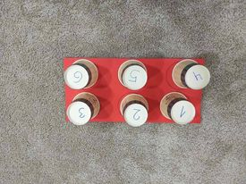
Montessori in preschool period
Project number: 2020-1-TR01-KA229-092143
Place the number in the corresponding place!
- Numbers from one to six are marked on a sheet of paper. The numbers from one to six are also marked on the cardboard cups. Place the glass with the number on the corresponding number on the sheet.

Slide 4
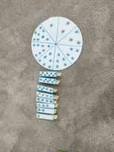
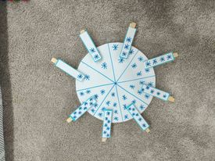
Montessori in preschool period
Project number: 2020-1-TR01-KA229-092143
Snowflakes
- A cardboard circle is divided into 8 parts, each part has snowflakes drawn on it. In the clothspins, there are small sheets on which snowflakes are also drawn. Place the clothspins corresponding to the snowflakes found in the circle according to the snowflakes found on the clothspins.

Slide 5
Montessori in preschool period
Project number: 2020-1-TR01-KA229-092143
Colored sticks
The numbers from one to six are drawn on a cloth with pockets. And we also have some sticks with different colors. Count the sticks by color and according to the color, put in the pocket with the corresponding number how many sticks there are of that color.
For example: There are 4 yellow sticks, counts them and puts them in the pocket with number four.

Slide 6
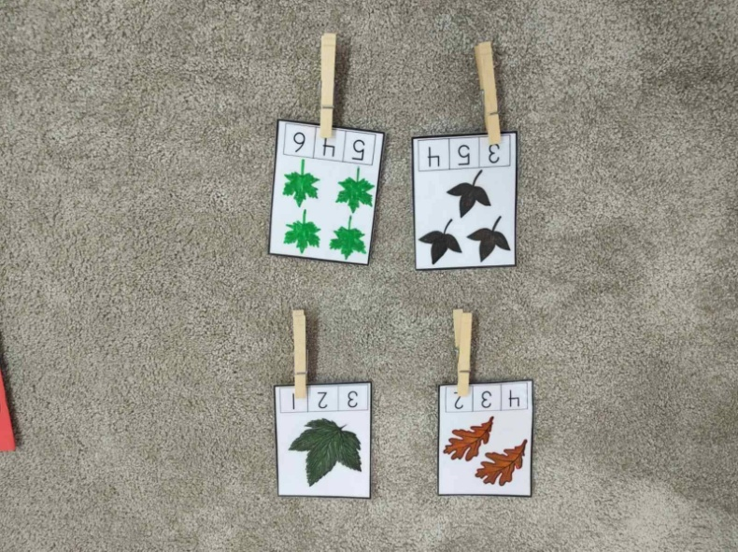
Montessori in preschool period
Project number: 2020-1-TR01-KA229-092143
How many leaves are there?
There are leaves drawn on the small sheets, and some numbers are written below them. Put the clothspins on the corresponding number according to the leaves on the sheets.
For example: In the first sheet there are two leaves, and the clothspin should be placed to the number two.

Slide 7
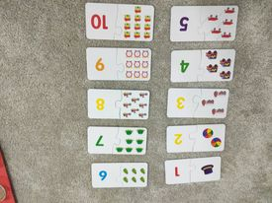
Montessori in preschool period
Project number: 2020-1-TR01-KA229-092143
Puzzles
In one part of the puzzle, are drawn objects, while in the other part, different numbers are written from 1 to 10. Combine the parts of the numbers with the number of the corresponding objects.
For example: the number two should combine with two balls.

Slide 8
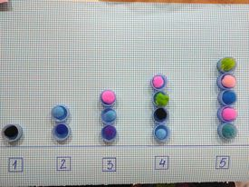
Montessori in preschool period
Project number: 2020-1-TR01-KA229-092143
Let's recycle bottle caps to learn to count!
Numbers from 1 to 5 are written on a card. Bottle caps are attached to them according to the corresponding number. Put as many balls on the caps as there are bottle caps.
For example: one ball where there is one cap.

Slide 9
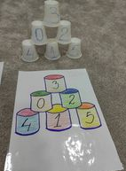
Montessori in preschool period
Project number: 2020-1-TR01-KA229-092143
Tower with numbers!
Cups with numbers are drawn on the paper. We also have numbers written on the plastic cups. Build a tower with plastic cups according to the corresponding photo with plastic cups on the sheet.

Slide 10
THANK YOU FOR YOUR ATTENTION!

