Slide 1
Montessori in preschool period
Project number: 2020-1-TR01-KA229-092143

Slide 2
Montessori in preschool period
Project number: 2020-1-TR01-KA229-092143
The activities of the Turkish team that have been applied in our kindergarten

Slide 3
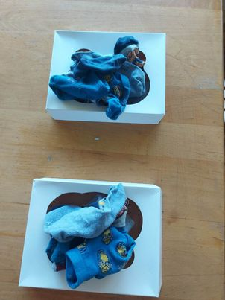
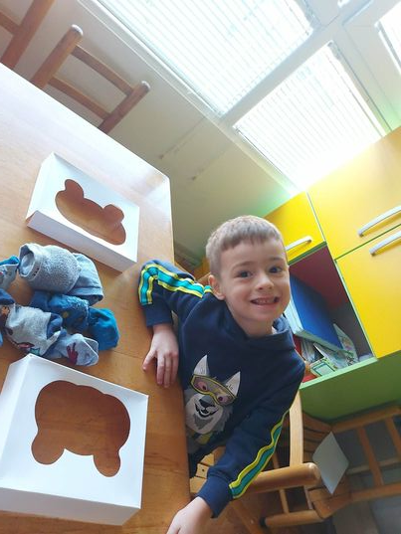
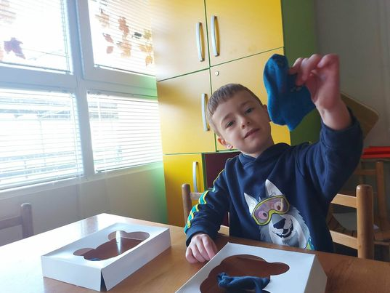
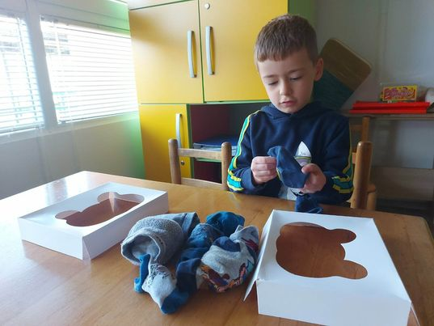
Montessori in preschool period
Project number: 2020-1-TR01-KA229-092143
Sock folding
- Different patterns and colors of socks are placed in front of the child in a mixed manner. The child is expected to match the socks according to their patterns and colors (grouping and folding).

Slide 4
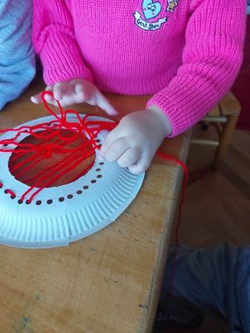
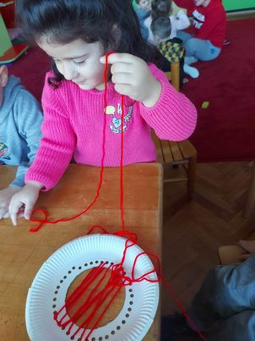
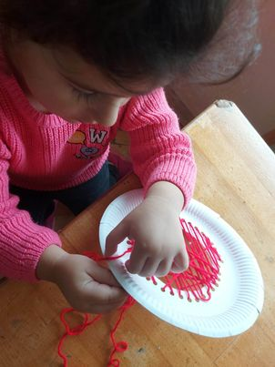
Montessori in preschool period
Project number: 2020-1-TR01-KA229-092143
Sewing
- To children are given foam plates, plastic needles and thread, which are patterned with hole punches, they are expected to do sewing work.

Slide 5
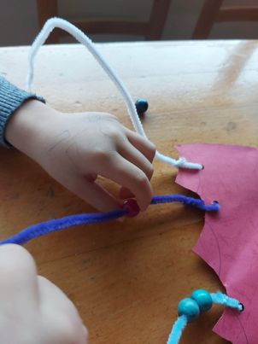
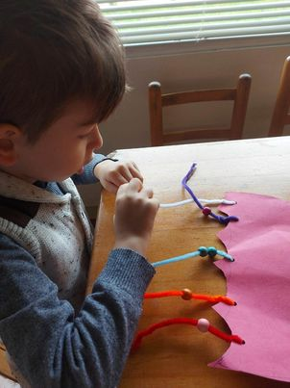
Montessori in preschool period
Project number: 2020-1-TR01-KA229-092143
Puppy Octopus
- The octopus with arms made of yarn is given to the children and they are expected to string beads on the string.

Slide 6
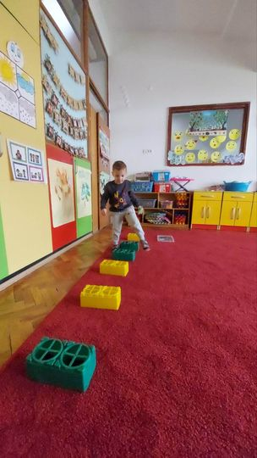
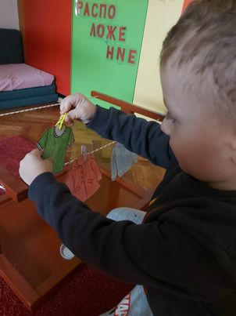
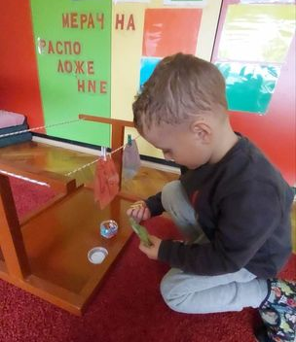
Montessori in preschool period
Project number: 2020-1-TR01-KA229-092143
Blue passion crow
- The children are expected to attach the materials to the rope with clothespins in the desired time.

Slide 7
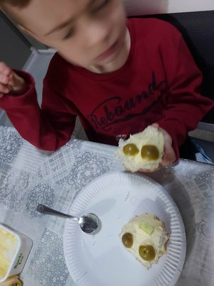
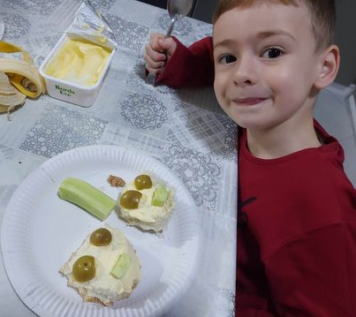
Montessori in preschool period
Project number: 2020-1-TR01-KA229-092143
Preparing sandwich
- The sandwich ingredients are placed on the tray and the child is expected to prepare a sandwich for himself with the material he wants.

Slide 8
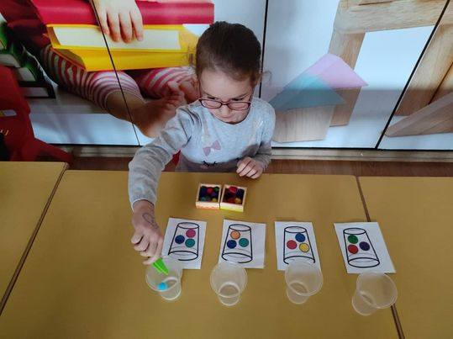
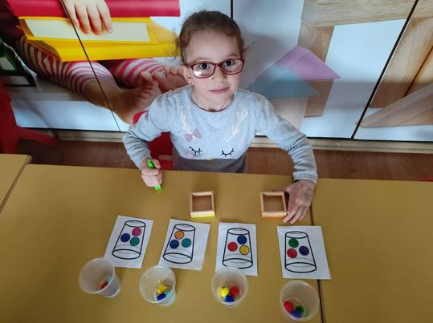
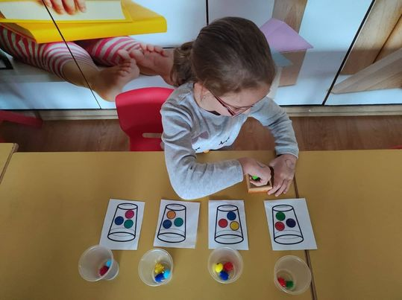
Montessori in preschool period
Project number: 2020-1-TR01-KA229-092143
Like elmer with plastic glass and balls
- The child is expected to do the transfer work by matching the balls in the glass.

Slide 9
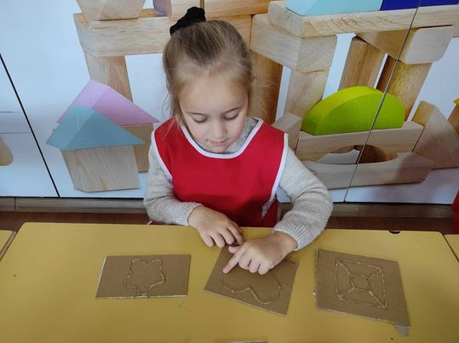
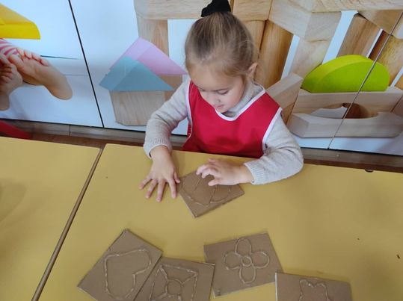
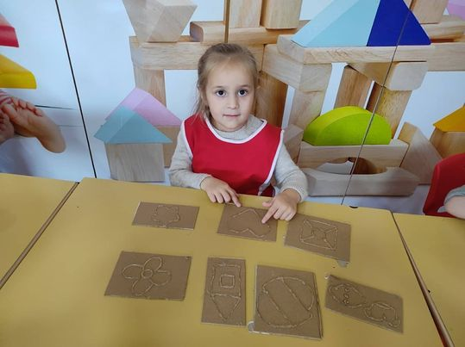
Montessori in preschool period
Project number: 2020-1-TR01-KA229-092143
Touch – feel - tell
- By blindfolding the child, it is expected that he/she touches the cards with colored silicone and guesses what the drawn shape is.

Slide 10
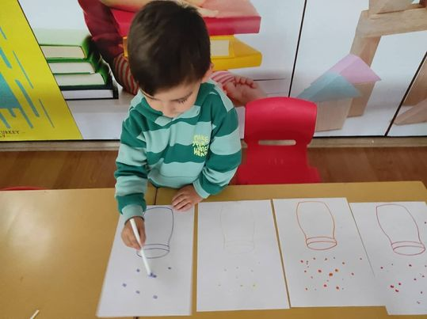
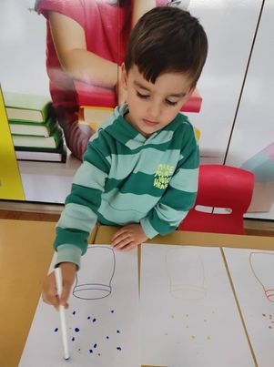
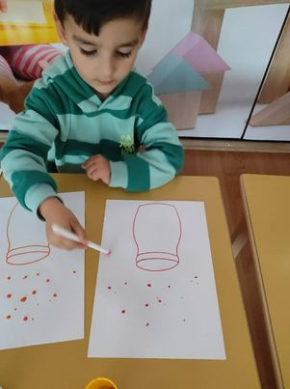
Montessori in preschool period
Project number: 2020-1-TR01-KA229-092143
Color matching with drop
- Jars with colored water in them, pictures of jars with colored lids on oiled paper and droppers are placed on the table. The child is expected to match the water taken from the jar to the dropper with the same color jar in the picture.

Slide 11
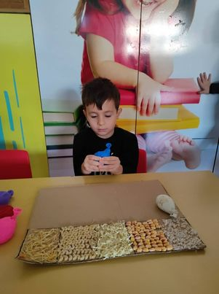
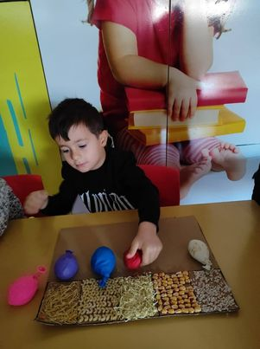
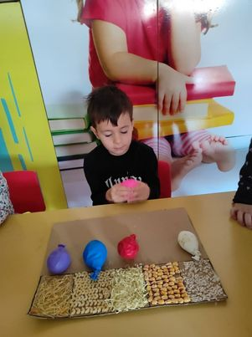
Montessori in preschool period
Project number: 2020-1-TR01-KA229-092143
Sense balloons
- Balloons and different sensory are placed in front of the children. They are expected to fill these materials in balloons and they will find what is.

Slide 12
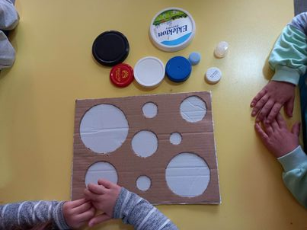
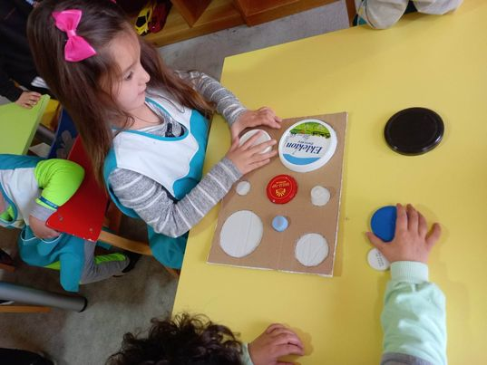
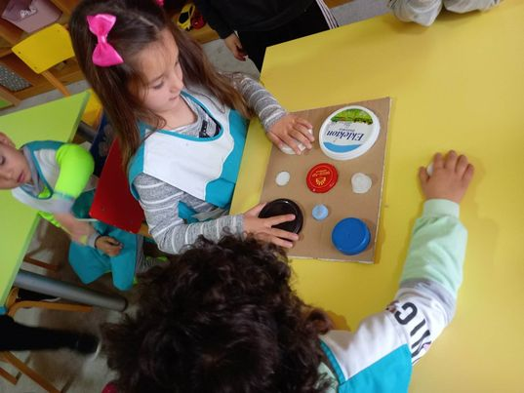
Montessori in preschool period
Project number: 2020-1-TR01-KA229-092143
Cover matching
- Circles are drawn on the cardboard in the size of the covers in different sizes. The child is expected to place the covers on the cardboard correctly.

Slide 13
Montessori in preschool period
Project number: 2020-1-TR01-KA229-092143
The activities of the Slovenian team that have been applied in our kindergarten

Slide 14
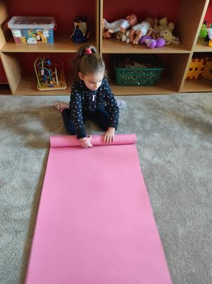
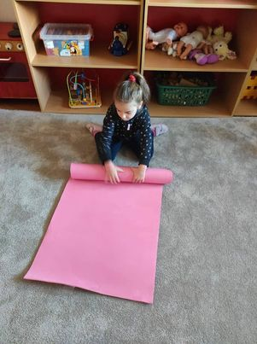
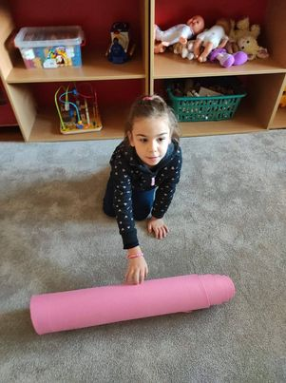
Montessori in preschool period
Project number: 2020-1-TR01-KA229-092143
The work mat
- Activities which are more comfortable to done on the floor, and for these we use a work rug/mat.

Slide 15
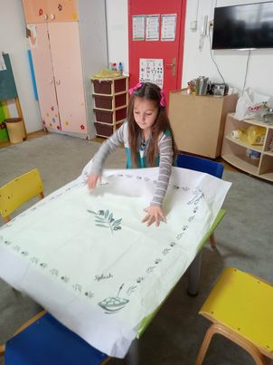
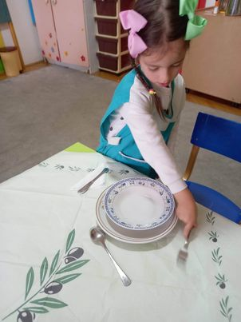
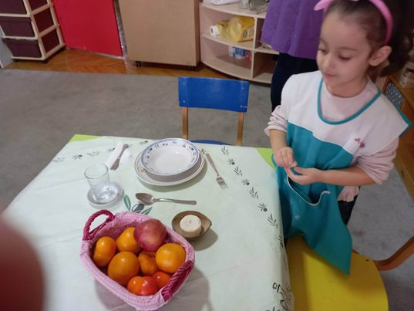
Montessori in preschool period
Project number: 2020-1-TR01-KA229-092143
Transmission prenasanje
- Chair
- Mug filled with water
- Pot with pedestal
- Tray with glasses, fruit basket, box, bell or candle
- Table

Slide 16
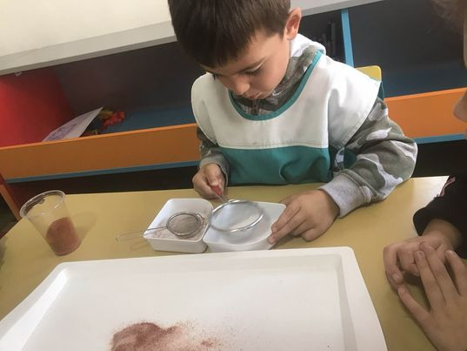
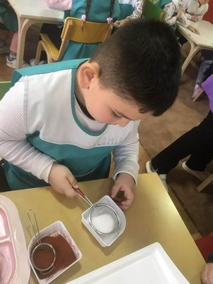
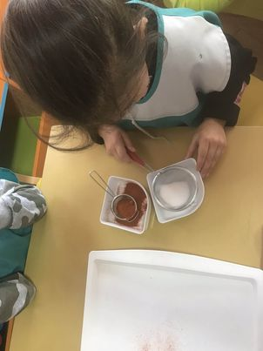
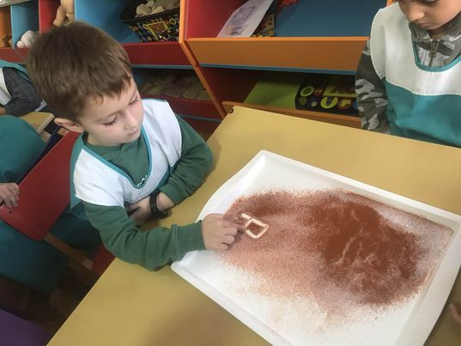
Montessori in preschool period
Project number: 2020-1-TR01-KA229-092143
Sorting
Separation of solids with tweezers.
Screening and separation of the two substances.

Slide 17
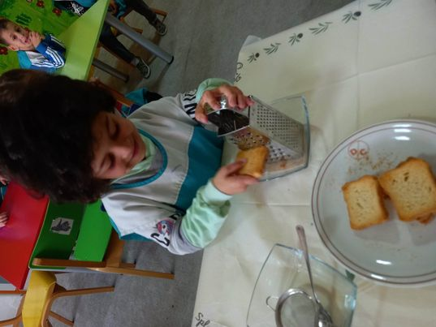
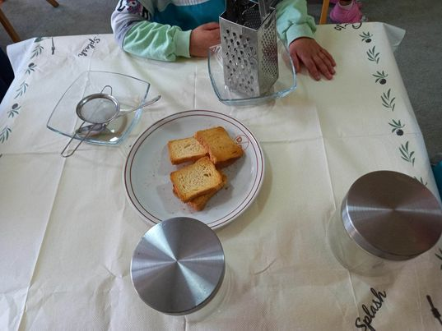
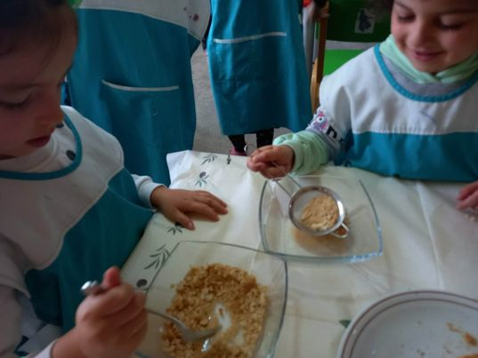
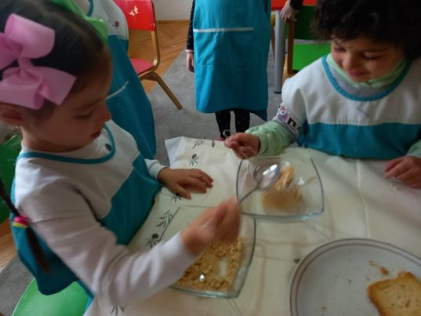
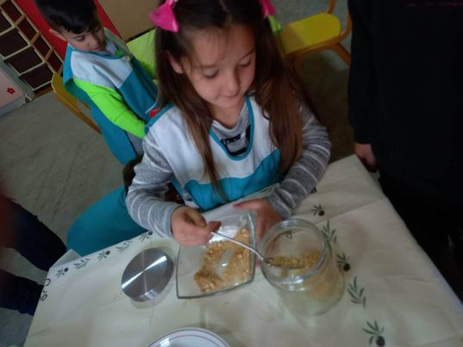
Montessori in preschool period
Project number: 2020-1-TR01-KA229-092143
Grating dry bread

Slide 18
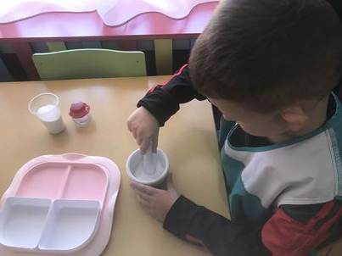
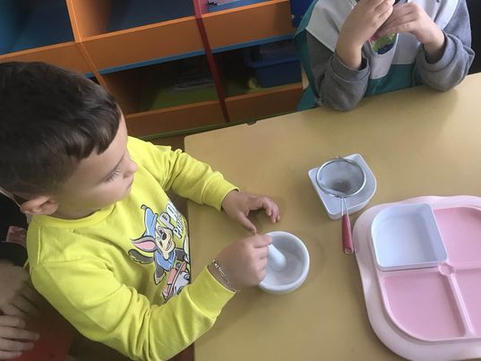
Montessori in preschool period
Project number: 2020-1-TR01-KA229-092143
Crushing coarse salt

Slide 19
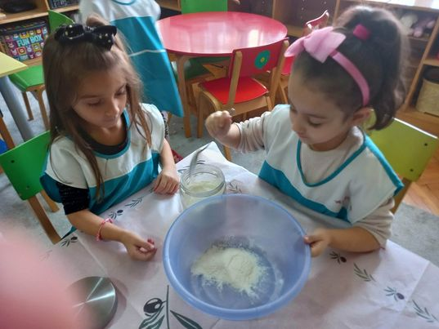
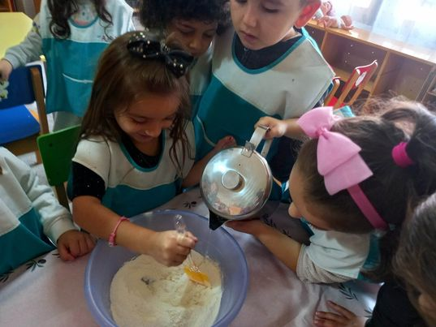
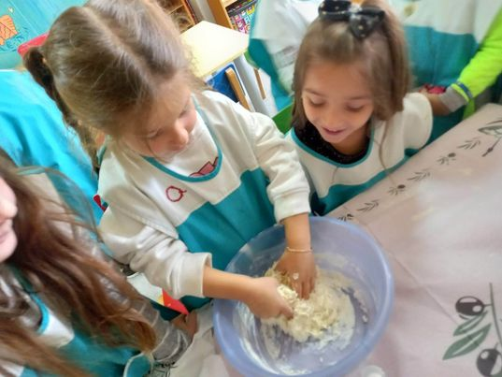
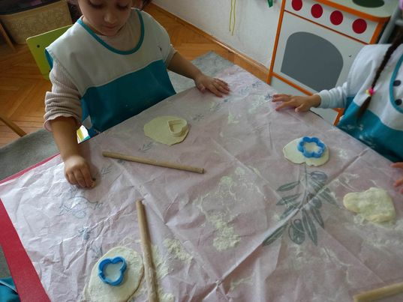
Montessori in preschool period
Project number: 2020-1-TR01-KA229-092143
Preparation of salt dough

Slide 20
Montessori in preschool period
Project number: 2020-1-TR01-KA229-092143
Perforation
Material:
- tray
harder base of foam, felt or cardboard
pin poking pencil
different models for outline
pencil and paper for outlining different shapes in box

Slide 21
Montessori in preschool period
Project number: 2020-1-TR01-KA229-092143
Sound boxes
Refine the auditory sense.

Slide 22
Montessori in preschool period
Project number: 2020-1-TR01-KA229-092143
Like cubes and balls (cubes and rectangles)
Stereogrnostic feeling

Slide 23
Montessori in preschool period
Project number: 2020-1-TR01-KA229-092143
Sensorial bag
Material:
Cloth bag
Different object in pairs

Slide 24
Montessori in preschool period
Project number: 2020-1-TR01-KA229-092143
The activities of the Italian team that have been applied in our kindergarten

Slide 25
Montessori in preschool period
Project number: 2020-1-TR01-KA229-092143
Making an healthy snake
Making an healthy snake with the fruits of season.

Slide 26
Montessori in preschool period
Project number: 2020-1-TR01-KA229-092143
Like Cinderella
We clean the exercise room when we pour the games.

Slide 27
Montessori in preschool period
Project number: 2020-1-TR01-KA229-092143
How to wash lego?
Step 1: Washing
Step 2: Rinsing
Step 3: Voltage

Slide 28
Montessori in preschool period
Project number: 2020-1-TR01-KA229-092143
Discovering fossil by sensory bag (fox)
Discovering the animal in senosrial bag – fox.

Slide 29
Montessori in preschool period
Project number: 2020-1-TR01-KA229-092143
Mix, touch and create colors

Slide 30
Montessori in preschool period
Project number: 2020-1-TR01-KA229-092143
Like Kim’s game
- Remember as many items as possible on the tray.

Slide 31
Montessori in preschool period
Project number: 2020-1-TR01-KA229-092143
Make your frozen eggs (animal, objects)

Slide 32
Montessori in preschool period
Project number: 2020-1-TR01-KA229-092143
How to set up sensory writing trays with salt or other materials (rice, white bean, salt)

Slide 33
Montessori in preschool period
Project number: 2020-1-TR01-KA229-092143
Sensory bottle
- Empty water bottle, few drops of food coloring, baby oil, water. Shake it.

Slide 34
Montessori in preschool period
Project number: 2020-1-TR01-KA229-092143
Sponge salad
Sponge
Seed
Water

Slide 35
THANK YOU FOR YOUR ATTENTION!

